Slide 1
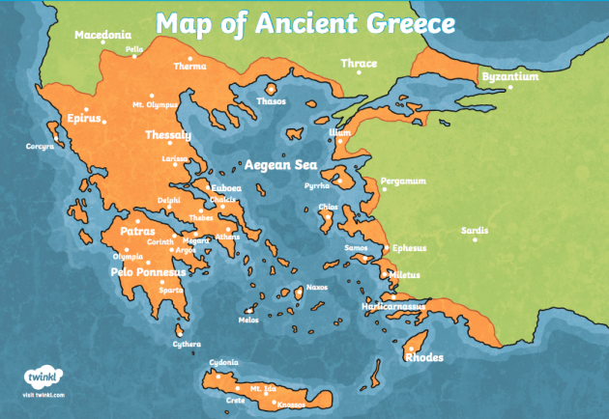
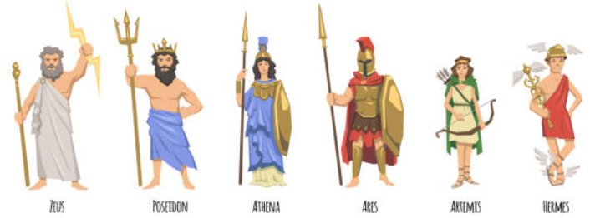
Shirley Heath Ancient Greece | Year 3 | Spring Term
Key Facts
Ancient Greece was a civilisation from 1200BC – 323BC that started in Crete. The two big city-states that ruled a lot of Ancient Greece were Athens and Sparta.
In Ancient Greece, there were highly organised cities. Ancient Greece was full of rich culture, including food, music and literature.
Ancient Greeks believed in a number of Gods/Goddesses who controlled different parts of life. Zeus was the King of the Gods. The Gods lived on Mount Olympus.
A primary source is an object from that period of time. Primary sources help us to learn about different periods of time. Vases are a key primary source from Ancient Greece
Myths were told to describe and discuss issues in society. Myths were a large part of religion in Ancient Greece. Different myths were displayed on different artefacts.
The first Olympics happened in 776BC. The first Olympics happened in Olympia. It was a sporting and religious event.
The Persian War was a war between Persia and Greece. Athens and Sparta united to fight against Persia. Cause - Persia wanted to conquer Greece, consequence - there was a 50 year war between Persia and Greece.
The Ancient Greeks created democracy. The Ancient Greeks created the alphabet and ideas that are still used in Maths and Science. The Ancient Greeks had a unique style of architecture.
Modern Britain’s government type is democracy. Modern Britain’s alphabet is based on the Greek alphabet. Many aspects of Modern Britain are influenced by achievements from Ancient Greece.
Vocabulary
Civilisation | A society with its own social organization and culture.
City-states | A city that has its own government.
Sparta | One of the most powerful city-states in Ancient Greece
Athens | Capital city of Greece, where democracy originated from.
Architecture | Buildings and other physical structures
Artefacts | An object that has been made by a person and is from a period of time
Government | A group of people that have the power to rule.
Zeus | A powerful god, he was considered to be the ruler and protector of all gods and humans.
Olympia | A place in Ancient Greece
Invasion | To enter as an enemy, by force, in order to conquer
Culture | A person who watches an activity
Persia | The country now known as Iran
Democracy | The people elect the government and have a say in how it is run

