Slide 1
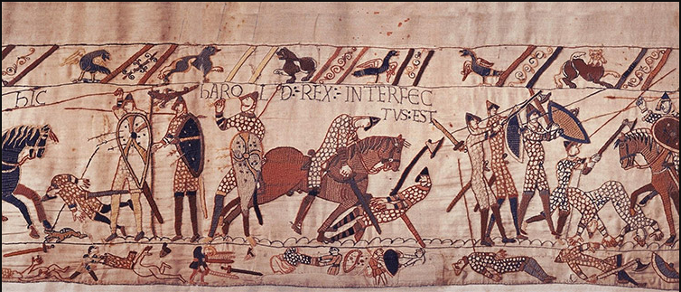
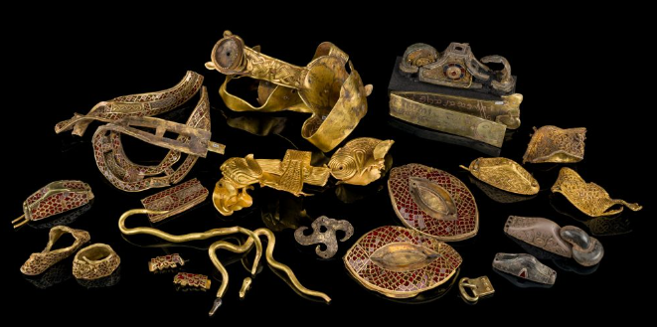
Shirley Heath Anglo Saxons and Vikings | Year 4 | Spring 1 & 2
Key Facts
Anglo-Saxons came from many places, mainly Denmark, Germany and the Netherlands and they lived in Britain between 410 AD and 1066 AD. They were originally invited to defend Britain and the Romans. The Anglo-Saxons split Britain into kingdoms.
Sutton Hoo was a burial ground for a king and historians discovered a large number of artefacts that revealed a lot about Anglo-Saxon religion. Anglo-Saxons were Pagans and gradually became Christians.
Each kingdom had a king to rule over them, and they created the laws. The first King was called Egbert. King Athelstan was the first king of England in 924 – 939.
Alfred the Great was King of Wessex from 849 – 899. He brought about many reforms and was a fair ruler. He defeated the Vikings and created a peace treaty with them.
The Staffordshire Hoard, found in 2009, was the largest hoard of Anglo-Saxon gold and silver metalwork found.
The Vikings were from Norway, Sweden and Denmark. They invaded Britain and starting settling from 793AD. By 878AD the Vikings had control of the Danelaw (Viking lands), to the north and east of England
The community would meet at a Thing to solve disputes. The law-speaker would remember the laws and share these around the community. The chieftain would help to settle disputes.
The Battle of Hastings happened in 1066 and was caused because Edward the Confessor died and William the Duke of Normandy wanted to be king. William killed Harold Godwinson (the king of England) and became king. The Bayeux Tapestry shows the Battle of Hastings.
There are some similarities in modern day Britain and the Anglo-Saxon and Viking era, including place names. The Vikings lived in Longhouses.
Vocabulary
Anglo Saxons | Made up of the Angles, Saxons and Jutes. 410AD - 1066 AD.
Angles, Saxons and Jutes | German tribes who came to England from across the North Sea
Kingdoms | Made up of land from the same region or territory that is ruled by a king
Sutton Hoo | A burial ground found in 1939
Artefacts | An object from a period of time
Reforms | Changes and improvements to laws
Peace treaty | An official agreement which ends a conflict
Hoard | A collection of valuable objects
Archaeologist | Somebody who looks at ancient sites and objects
Raids | A sudden, surprise attack
Settled | Living in an area
Invasions | Taking over a piece of land in another country/area
Danelaw | The name of the area of England that officially belonged to the Vikings
Law-speaker | The person who memorized all the laws of a community
Chieftain | The leader of the community
Settlements | Places where people live and sometimes work

