Slide 1
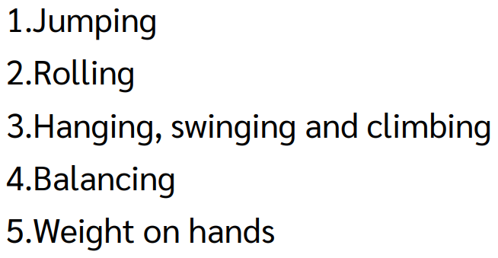
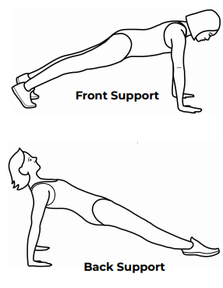
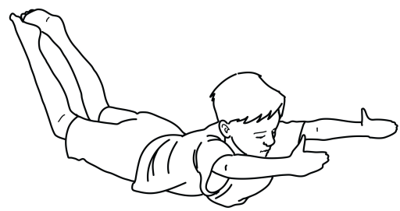
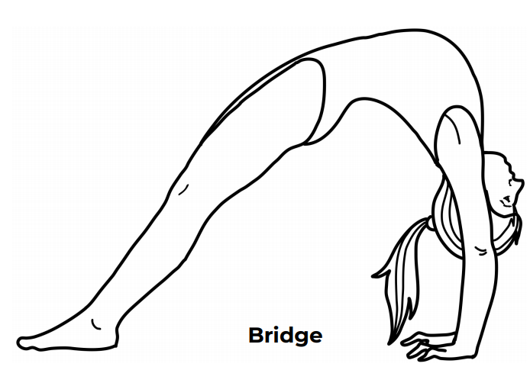
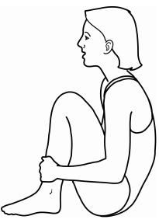
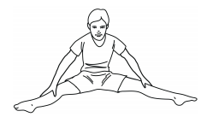
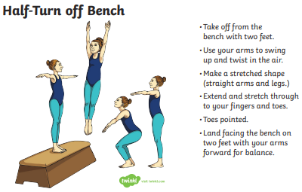
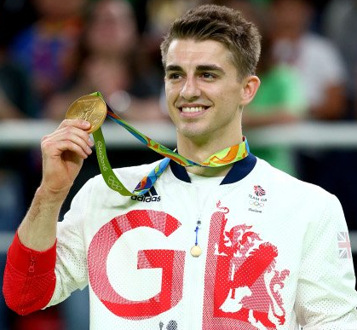
Shirley Heath Year 3, Spring 1: Gymnastics
Vocabulary
1 | Fluency | To continue a movement.
2 | Contrasting | Do complete an opposite move.
3 | Full turn | Move 360 degrees.
4 | Half-turn | Move 180 degrees.
5 | Control | To influence a certain movement.
6 | Combinations | Do complete certain routines one after another
7 | Bounce | Move up and down
5 Gym Categories:
Arch
Tuck
Bridge
Teddy-Bear Roll
Max Whitlock MBE:
Whitlock is a five-time Gymnastic Olympic medalist, winning two golds and three bronzes, and a eight-time world medalist with three gold and five silvers. He became Britain's first ever gold medalist in artistic gymnastics when he won both the men's floor and pommel horse exercises at the 2016 Summer Olympics

