Slide 1
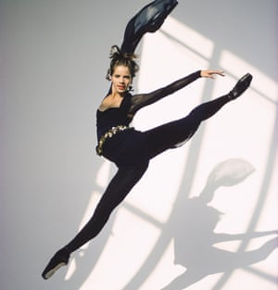
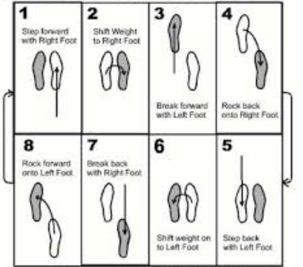
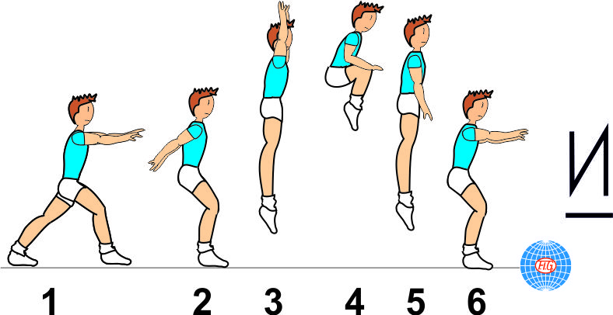
Shirley Heath Year 3, Spring 2: Dance
Character Profiling
This unit will incorporate characters from Matilda.
Skills and Vocabulary
1 | Balance | Being able to keep a stable body (without wobbling or falling) over a base of support (Eg, Hands or feet)
2 | Body Awareness | Understanding how your body is moving in time to the music, without having to look in a mirror.
3 | Control | The power to direct your body and body parts to master dance moves
4 | Co-ordination | Being able to move different body parts at the same time.
5 | Rhythm / Timing | Being able to listen to the beat of a music and ensure that your body moves in time with the beat
6 | Spatial Awareness | Using the correct amount of space when performing. This links to the safety aspect of the sport.
Skill Development: Jazz Square:
1 step right foot forward,
2 cross over with left,
3 step back on the right,
4 step back with left.
Dame Darcey Bussell:
Bussell is an English retired ballerina and a former judge on the BBC television dance contest Strictly Come Dancing.
Tuck Jump:
Performing a tuck jump off a char. This is to performed on a chair afterwards.

