Slide 1
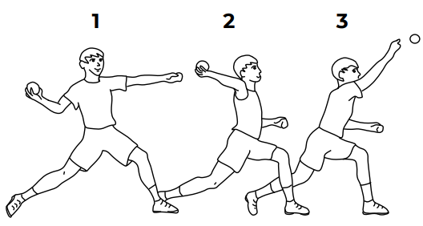
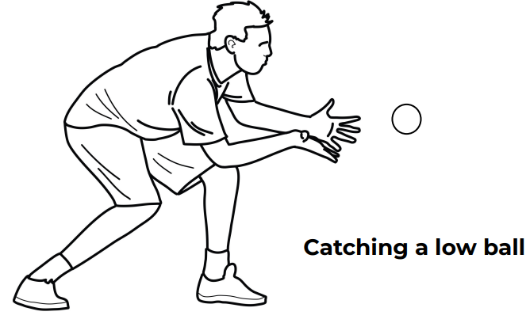
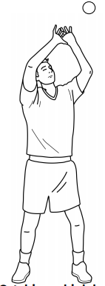
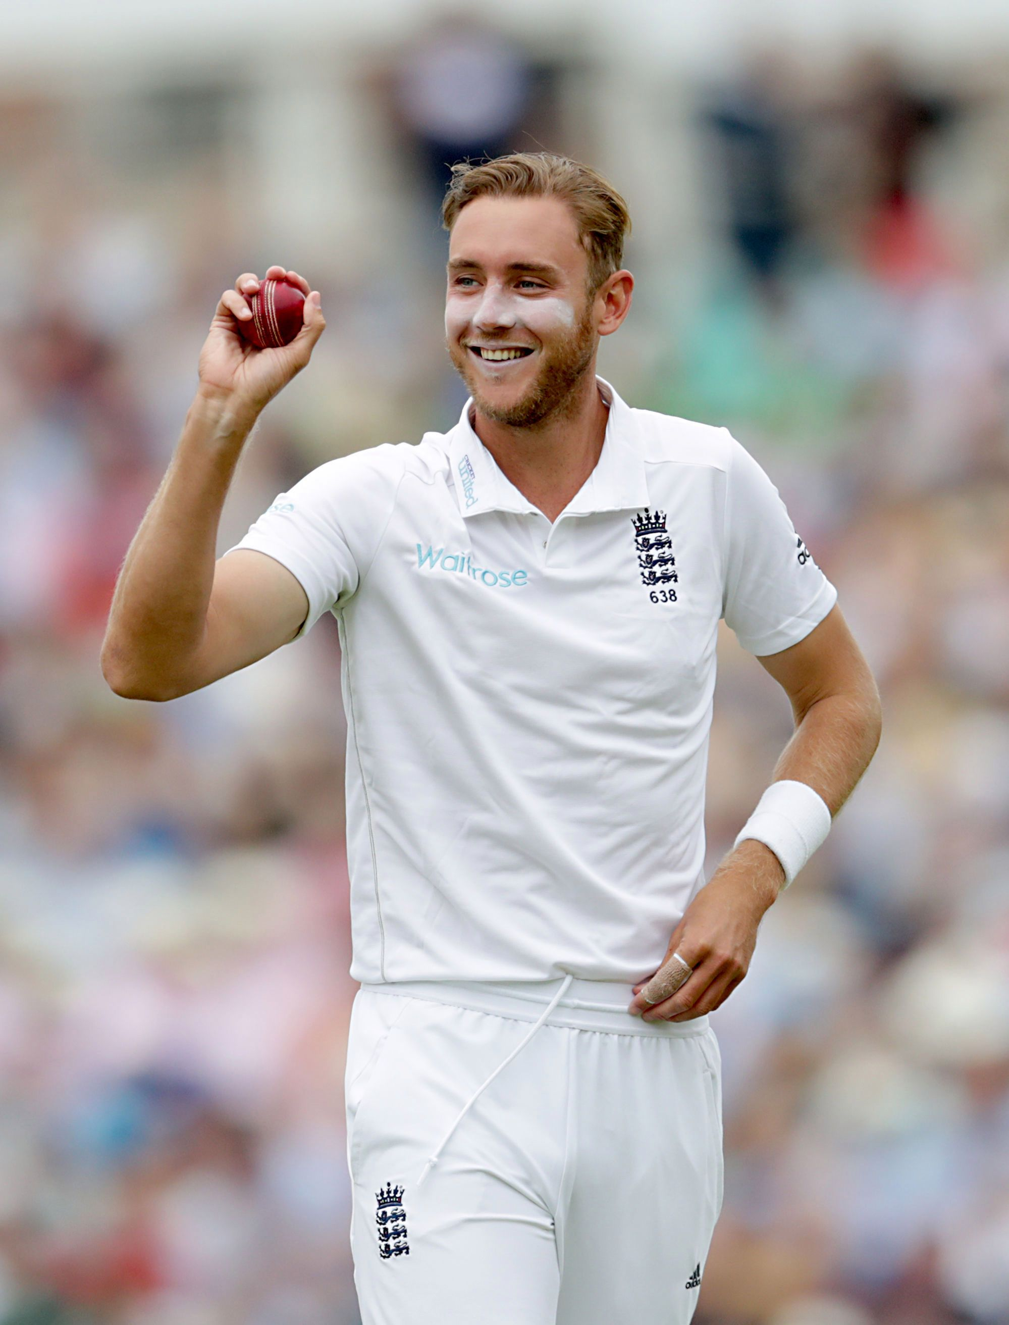
Shirley Heath Year 4, Spring 2: Cricket (Chance to Shine)
Vocabulary
1 | Batting | Hitting the ball after it is bowled.
2 | Fielding | Catching / bowling/ stumping of the ball – against the opposition batsman
3 | Bowling Year 4 do not bowl – bowling comes in Year 5. | Throwing the ball at a batsman in the hope it hits the stumps.
4 | Wicket / Stumps | What a batsman is defending by hitting the ball; what a fielder is trying to aim at and knock down to get the batsman out.
5 | Boundary | The scoring zone.
6 | Innings | Changing of batting and fielding. In conventional cricket, there are two innings (two batting + two fielding)
7 | Run | Running between two wickets to score a point.
8 | Batsman | The player hitting the ball with a bat.
9 | Fielder | A player receiving the ball from a batsman
Overarm throw action (Fielding only)
Catching (cup)
Stuart Broad MBE:
Broad is an English cricketer who plays Test cricket for the England cricket team and a former ODI and T20 captain.
Skills
1 | Battling | A skill which allows the bat to contact the ball.
2 | Throwing | A technique to field the ball to the correct position at the correct pace and direction
3 | Catching | The ability to get in the correct position for the batter to hit.
4 | Bowling | A technique to deliver the ball in the correct position for the batter to hit. Year 4 do not bowl – bowling comes in Year 5.
5 | Match Play | A skill used to understand the basics of the game, the scoring, the rules and the player’s positions.

