Slide 1
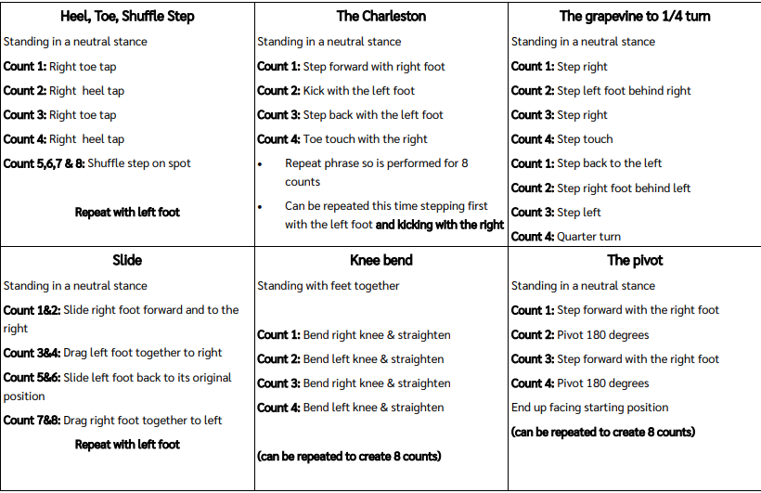
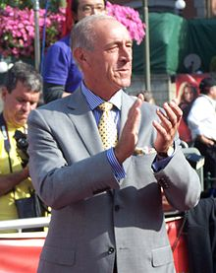
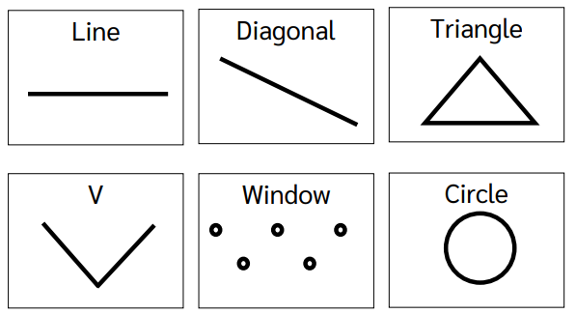
Shirley Heath Year 5 , Spring 1: Dance
Dance Steps Guide:
Skills and Vocabulary
1 | Balance | Being able to keep a stable body (without wobbling or falling) over a base of support (Eg, Hands or feet)
2 | Body Awareness | Understanding how your body is moving in time to the music, without having to look in a mirror.
3 | Choreography | Being able to create a dance or set of dance moves.
4 | Control | The power to direct your body and body parts to master dance moves
5 | Co-ordination | Being able to move different body parts at the same time.
6 | Dynamics | Being able to change your body moves. Eg, fast, slow, jerky, smooth etc.
7 | Expression | Being able to show a story through the medium of dance.
8 | Rhythm / Timing | Being able to listen to the beat of a music and ensure that your body moves in time with the beat
9 | Spatial Awareness | Using the correct amount of space when performing. This links to the safety aspect of the sport.
Formations of Dance:
Len Goodman:
Leonard Gordon Goodman (born 25 April 1944) is an English professional ballroom dancer, dance judge, and coach.

