Slide 1
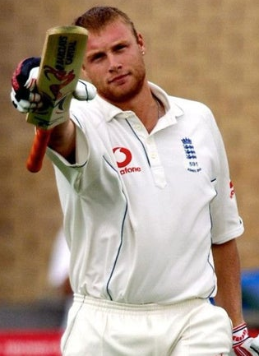
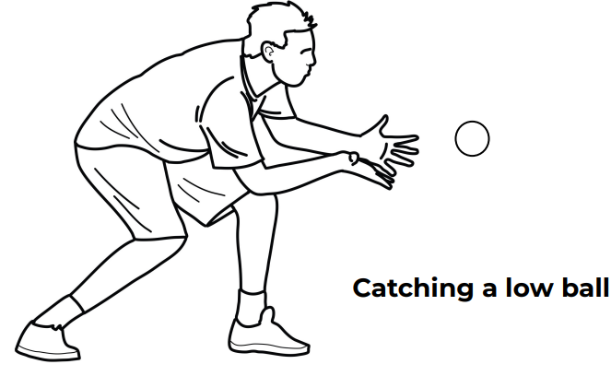
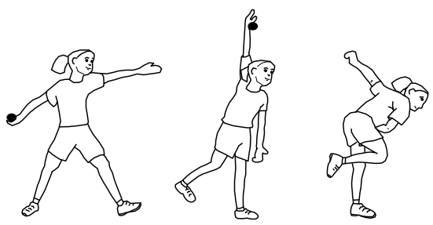
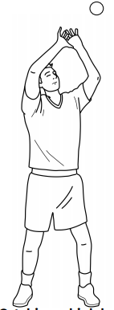
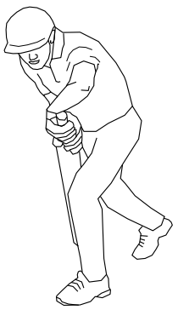
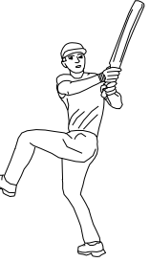
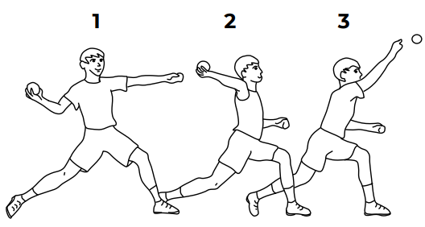
Shirley Heath Year 5 Spring 2 (Chance 2 Shine) UNIT TITLE: Cricket
Skills
1 | Battling | A skill which allows the bat to contact the ball.
2 | Throwing | A technique to field the ball to the correct position at the correct pace and direction
3 | Catching | The ability to get in the correct position for the batter to hit.
4 | Bowling | A technique to deliver the ball in the correct position for the batter to hit.
5 | Match Play | A skill used to understand the basics of the game, the scoring, the rules and the player’s positions.
Vocabulary
1 | Batting | Hitting the ball after it is bowled.
2 | Fielding | Catching / bowling/ stumping of the ball – against the opposition batsman
3 | Bowling | Throwing the ball at a batsman in the hope it hits the stumps.
4 | Wicket / Stumps | What a batsman is defending by hitting the ball; what a fielder is trying to aim at and knock down to get the batsman out.
5 | Boundary | The scoring zone: if it hit the ground prior to going over the boundary the batsman scores 4, without touching the ground the batsman scores 6.
6 | Innings | Changing of batting and fielding. In conventional cricket, there are two innings (two batting + two fielding)
7 | Run | Running between two wickets to score a point.
8 | Batsman | The player hitting the ball with a bat.
9 | Fielder | A player receiving the ball from a batsman
Progression: Overarm bowling & differing shot selection:
Andrew Flintoff MBE:
Flintoff played all forms of cricket and was one of the sport's leading all rounders, a fast bowler, middle order batsman and slip fielder.
Catching
Defensive Shot
Overarm Bowling action
Hook shot
Overarm throw action

