Slide 1
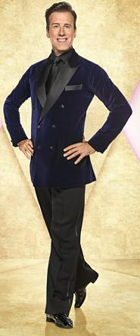
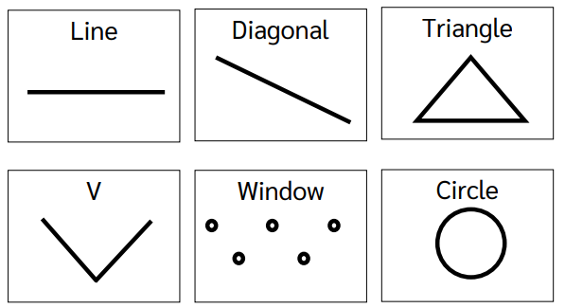
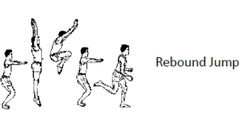
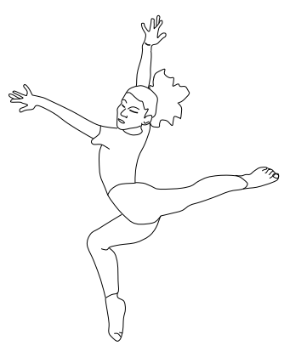
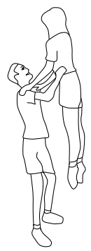
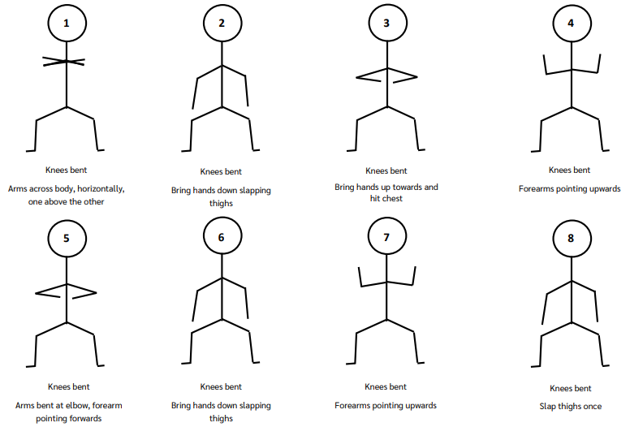
Shirley Heath Year 6, Spring 1: Dance
Consolidate the Formations of Dance (how you move during a routine (off the mat)):
Anton du Beke:
Du Beke is a British ballroom and Latin dancer who has been dancing since he was 10 years old.
Skills and Vocabulary
1 | Balance | Being able to keep a stable body (without wobbling or falling) over a base of support (Eg, Hands or feet)
2 | Body Awareness | Understanding how your body is moving in time to the music, without having to look in a mirror.
3 | Choreography | Being able to create a dance or set of dance moves.
4 | Control | The power to direct your body and body parts to master dance moves
5 | Co-ordination | Being able to move different body parts at the same time.
6 | Dynamics | Being able to change your body moves. Eg, fast, slow, jerky, smooth etc.
7 | Expression | Being able to show a story through the medium of dance.
8 | Rhythm / Timing | Being able to listen to the beat of a music and ensure that your body moves in time with the beat
9 | Spatial Awareness | Using the correct amount of space when performing. This links to the safety aspect of the sport.
10 | Unison | A technique when all performers complete the same movement at exactly the same time.
Stag Leap
Contact and Lift (Consider safety)
Peer Assessment
It is really important that you give advice and support to a friend. Do this by saying 2 good things you like about their sequence / routine, and one thing they could improve on.
Work towards the Hakka dance →
Use different heights
Work collaboratively
←

