Slide 1
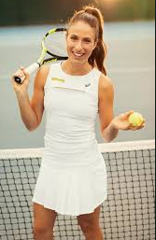
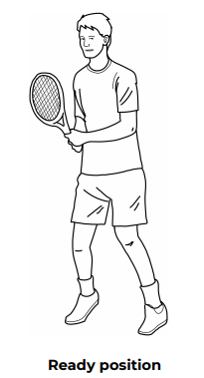
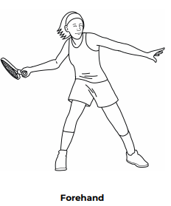
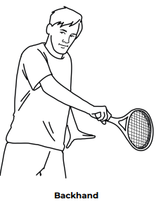
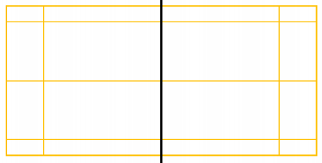
Shirley Heath Year 6, Spring 2: Tennis
Skills
1 | Lob Shot | A lofted shot played to the baseline to force the opposition player to run backwards.
2 | Volley | Hitting the ball without it bouncing.
3 | Overhead Shots | Moving your arm in a rotatory movement with the racket, hitting the tennis ball at its highest point to generate the most power and bounce.
4 | Doubles Tactics | Working with a partner, considering positioning on court, shot choices and the oppositions weaknesses.
5 | Positioning | Where each player stands on court. Back of the court = baseline.
Vocabulary
1 | Attacking | Forcing the opponent to each side of the baseline or close to the net.
2 | Defending | Purely returning, with the opposition dictating where the ball is landing on the court.
3 | Tactics | Deciding on positioning and shot choice.
4 | Scoring System | Love, 15, 30, 40, Game.
5 | Umpire | Tennis’ equivalent of a referee who decides whom wins the point.
6 | Diagonal | Cross court shot. From one corner of the court to the oppositions corner.
7 | Positioning | Where to stand on the court to generate the best chance of winning a point.
Johanna Konta:
Johanna Konta is a British professional tennis player who represented Australia until 2012. She has won three singles titles on the WTA Tour, as well as 11 singles and four doubles titles on the ITF Women's Circuit. The current British number one reached her best singles ranking of world No. 4 on 17 July 2017.
Court:
In preparation to receive a serve

