Slide 1
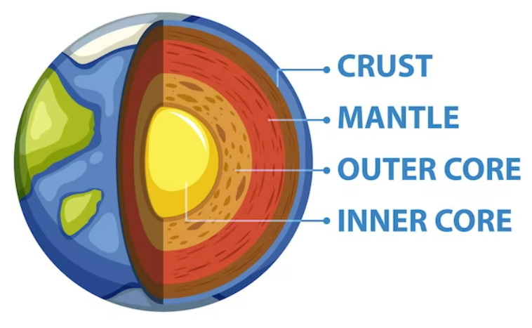
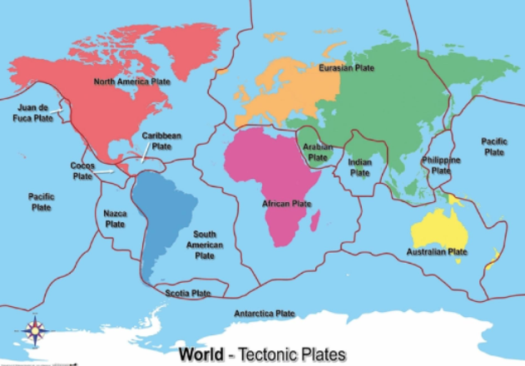
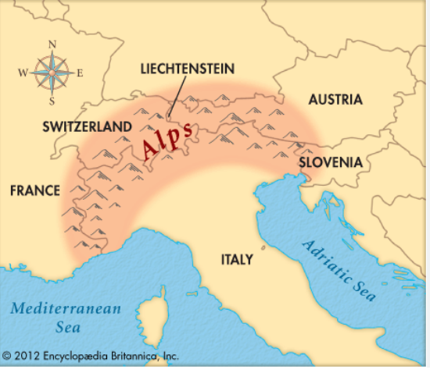
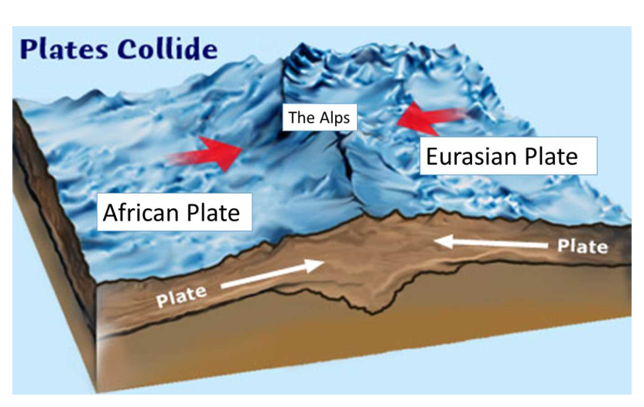
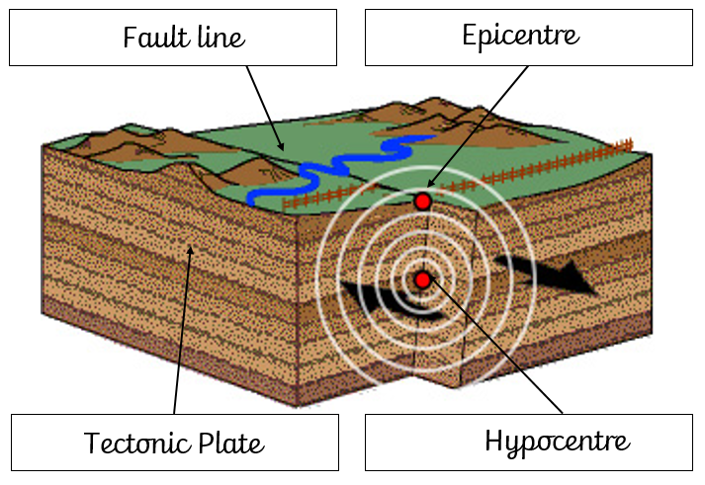
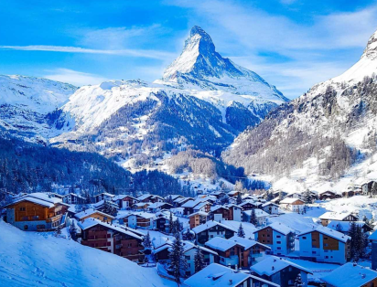
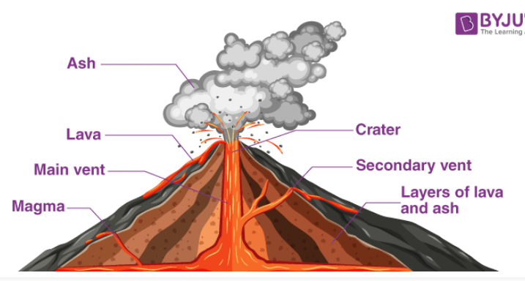
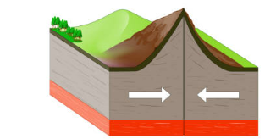
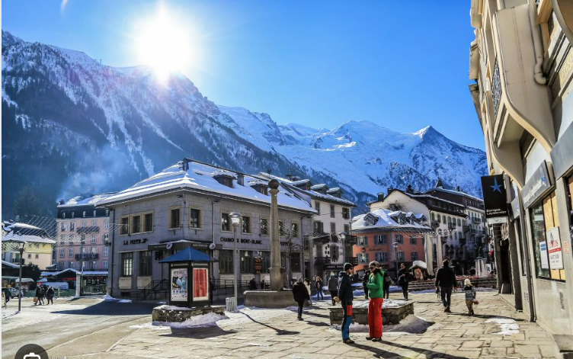
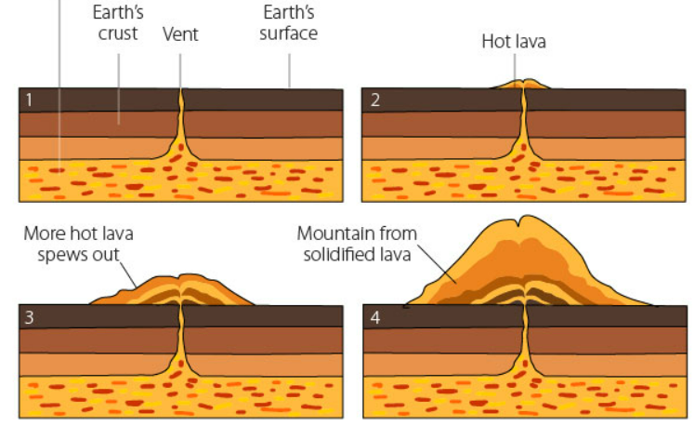
Shirley Heath Magnificent Mountains and Violent Volcanoes Year: 5 | Spring
THE ALPS
LOCATION | It is in south-eastern France. It is at the base of Mont-Blanc, the highest peak in the Alps.
COUNTRIES | Austria, France, Germany, Italy, Liechtenstein, Monaco, Slovenia, Switzerland.
MONT BLANC | Mont Blanc is the tallest mountain in the Alps. Chamonix is a town at the base of the mountain.
TOURISM | Famous for its skiing. It has 5 skiing resorts. Around 5 million tourists visit each year.
BIOMES | Alpine Biome
CLIMATE | -7 degrees in winter and 17 degrees in the summer. It has an alpine (mountain) climate
VOLCANOES
NEGATIVES | Destruction of forests, farmland and homes Ash clouds polluting rivers, killing fish and impacting jobs/food sources. Tsunamis and earthquakes occurring
POSITIVES | Rich, fertile soil created. New land created over time from hardened lava. Attracting tourists. Jobs created
VOCABULARY
Volcanoes | A mountain) that erupts lava/
Earthquakes | Two large pieces of the Earth's crust (tectonic plates) hit, causing shock waves
Ring of fire | an arc around the Pacific Ocean where many volcanoes and earthquakes are found
Fault lines | is a long crack in the surface of the earth
Tectonic plates | The Earth’s crust is made up of large, moving pieces called plates.
Boundaries | The edges of tectonic plates that meet each other.
Summit | Top of mountain
Face | A side of a mountain
Valley | The area of low land between mountains
Layers of the Earth
Tectonic Plates
The Alps
EARTHQUAKES
Fold Mountains
HOW ARE THEY FORMED?
Fold Mountains
Volcanoes
Mountains are formed when tectonics plates collide pushing up parts of the Earth’s crust.
Mont Blanc
Volcanoes form over many years, when magma is released through a vent to the Earth’s surface and hardens.
Chamonix

Slide 2
biome
Fieldwork
Longitutde
Latititue
Equator
Prime median
North and south hemp
Atlas

