Slide 1
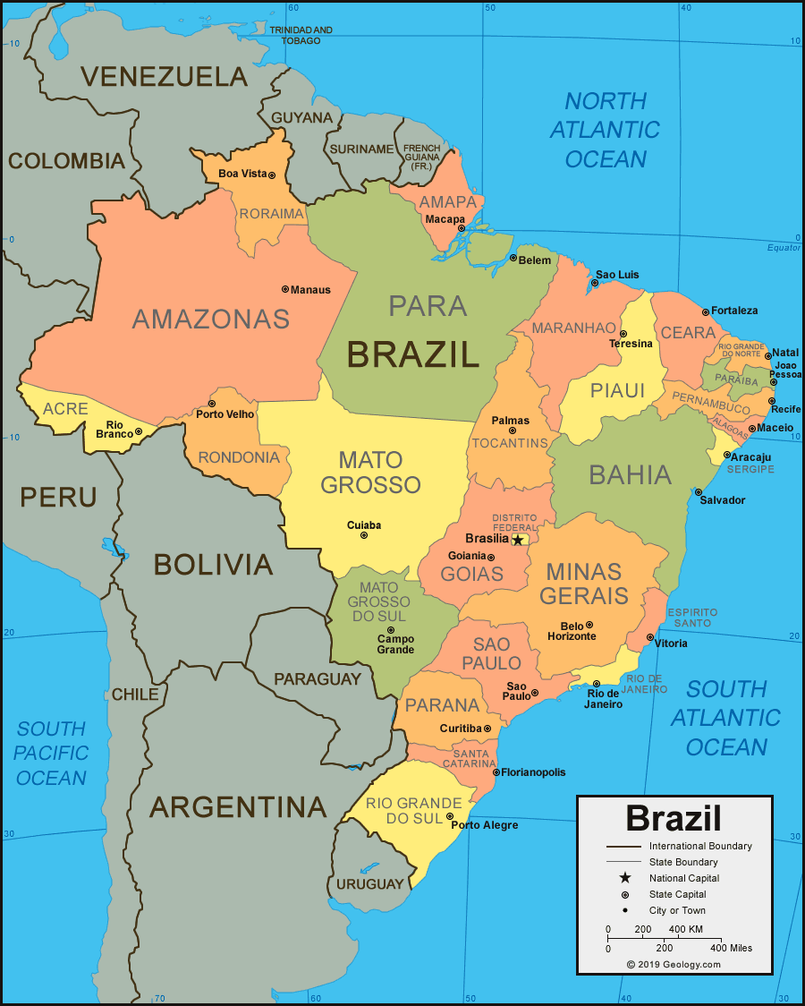
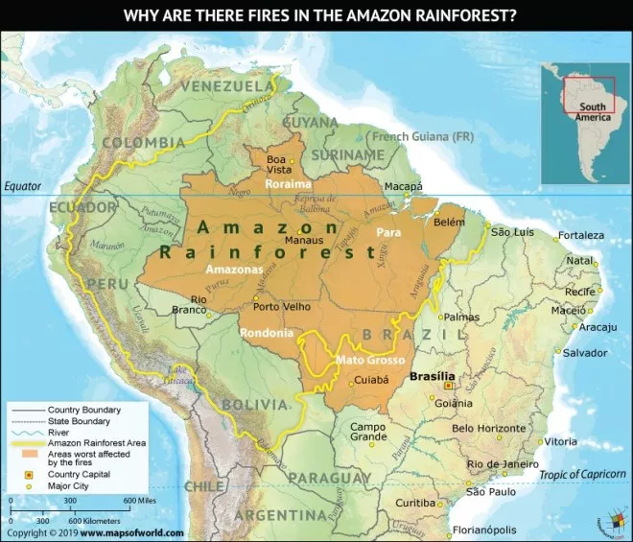
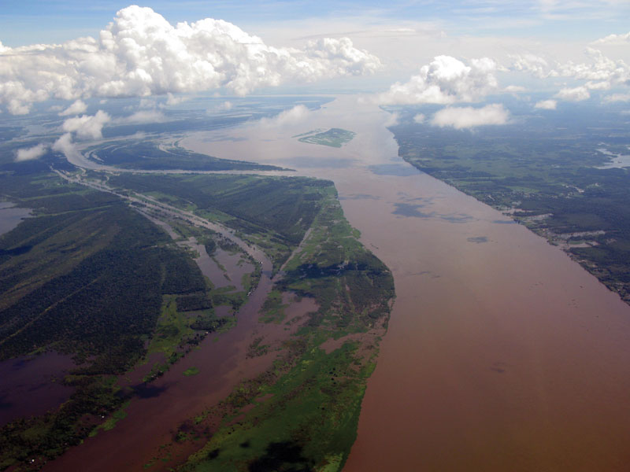
Shirley Heath Brilliant Brazil Year 6 | Spring
BRAZIL
Location
Main cities | Brasilia (capital), Rio de Janeiro, Sao Paolo, Manaus.
Tourism | Many people visit Brazil to see landmarks such as Sugarloaf Mountain and Christ the Redeemer
Language spoken | Portuguese
Settlements | Some poor people live in communities called favelas.
Biomes | Brazil has 6 biomes. The rainforest biome covers almost half of Brazil.
Climate | Brazil has 3 different climate zones – temperate, tropical and desert/arid
DEFORESTATION
How much? | Between 15-17% of the amazon rainforest has been deforested, this number is rising.
Causes | Cattle ranching, mining, farming, and road construction.
Impact | Tribes and animals homes are being destroyed Fewer species of animals and plants More carbon dioxide in the air contributing to global warming.
VOCABULARY
Biome | A community of plants and animals that have common characteristics.
Rainforest | A forest with high and regular rainfall (from 98-177 inches per year).
Vegetation belt | The type of plants found in a certain area.
Deforestation | The clearing, or cutting down, of forests.
Food trade distribution | The buying and selling of food.
Favela | A slum or shanty town
Indigenous | inhabiting or existing in a land from the earliest times
Fair trade | When fair prices are paid to the producers of foods and goods.
Global Warming | The increase of heat into the earth’s atmosphere
Brazil is the largest country in South America
AMAZON RAINFOREST
The Rainforest | It is the largest rainforest on earth.
Size | It covers 40% of South America and it spreads across 8 countries.
Layers | Forest floor, understorey layer, canopy layer and emergent layer.
The rainforest biome | It is the wettest biome in the world. Rain can range from 50 to 260 inches per year. It is very humid and temperatures don’t drop below 21 degrees.
Vegetation Belt | The Amazon rainforest vegetation belt is tropical grassland.
RIVER AMAZON
What is it? | The second longest river in the world and carries the highest amount of water.
Importance | It supports a variety of ecosystems (from natural savannah to swamp) and without them many would become extinct.
Uses | The Awa tribe use the River Amazon to transport themselves on rafts and canoes.
FOOD TRADE DISTRIBUTION
Exports (food it sells) | The biggest food exports are: sugar, bananas, coffee, tobacco, beef and corn.
Imports (food it buys) | The biggest food import is wheat.

