Slide 1
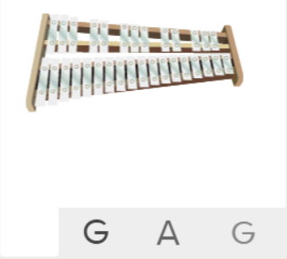
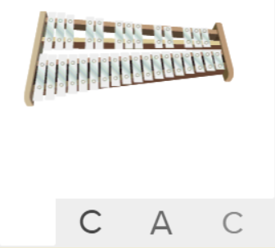
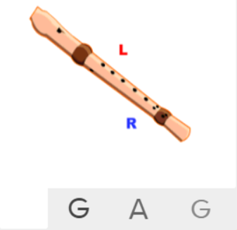
Shirley Heath Three Little Birds| Year 3 | Term: Spring 1
About This Unit
Themes: Reggae, happiness and animals.
Facts/info: Bob Marley is one of the most famous performers of Roots Reggae music. He has helped spread both Jamaican music and the Rastafari movement worldwide.
Listen to 5 other reggae songs: ‘Jamming’ by Bob Marley ‘Small People’ by Ziggy Marley ‘54-46 Was My Number’ by Toots and The Maytals ‘Ram Goat Liver’ by Pluto Shervington ‘Our Day Will Come’ by Amy Winehouse
Vocabulary
1. | INTRODUCTION | A passage or section which opens a movement or a separate piece, preceding the theme or lyrics.
2. | VERSE | When two or more sections of the song have almost identical music but different lyrics.
3. | CHORUS | The chorus is designed to be the most memorable section in a song. It often contains a hook or catchy refrain that a listener can easily remember, drawing them back to any individual track.
4. | BASS | The lowest part of the musical scale. It is also a type of guitar which usually has 4-5 strings.
5. | DRUMS | A drum is a musical instrument that you play by hitting it rhythmically with a stick or your hand.
6. | ELECTRIC GUITAR | A guitar that produces sound by vibrating strings over a pickup that converts the vibrations into electrical signals.
7. | KEYBOARD | A musical keyboard is the set of adjacent depressible levers or keys on a musical instrument.
8. | ORGAN | A keyboard instrument, operated by the player's hands and feet, in which pressurized air produces notes through a series of pipes organized in scale-like rows
9. | BACKING VOCALS | Singers who provides vocal harmony with the lead vocalist or other backing vocalists.
10. | Pulse | The regular heartbeat of the music; it’s steady beat.
11. | Rhythm | Long and short sounds or patterns that happen over the pulse.
12. | Pitch | High and low sounds.
13. | Tempo | The speed of the music; fast or slow or in-between.
14. | Dynamics | How loud or quiet the music is.
15. | TEXTURE | How the tempo, melodic, and harmonic materials are combined in a musical composition, determining the overall quality of the sound in a piece.
16. | Structure | The arrangement of a song.
17. | Compose | Writing your own music.
18. | Improvise | Playing notes that are not written for you.
19. | HOOK | A catchy combination of melody, lyrics and rhythm that stays in the listener's head
20. | RIFF | A pattern, or melody, often played by the rhythm section instruments or solo instrument, that forms the basis or accompaniment of a musical composition.
21. | Melody | The tune.
22. | REGGAE | A music genre that originated in Jamaica in the late 1960s.
Listen and Appraise: Three Little Birds (Reggae)
Structure: Introduction, chorus, verse, chorus, verse, chorus, chorus, chorus.
Instruments/voices you can hear: Bass, drums, electric guitar, keyboard, organ, male and backing vocals.
Find the pulse as you are listening: Dance, clap, sway, march, be an animal or a pop star.
Musical Activities (Using glocks / recorders)

