Slide 1
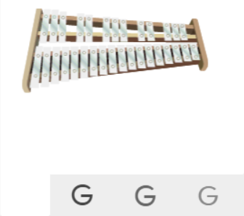
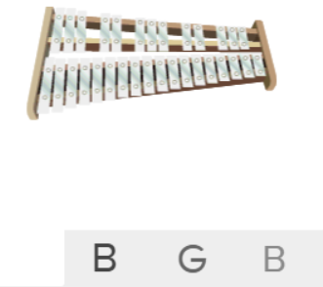
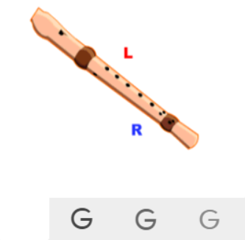
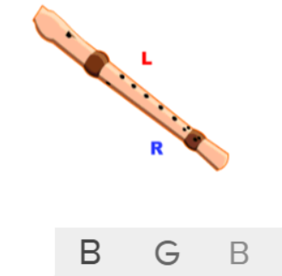
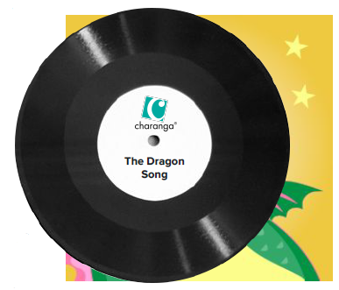
Shirley Heath The Dragon Song| Year 3 | Term: Spring 2
About This Unit
Themes: Traditional Folk tunes from around the world, celebrating our differences and being kind to one another.
Facts/info: This song tells the story of Lesley the Dragon who flies around the world in search of friendship. Think about the issues of kindness, respect, friendship, acceptance and happiness. Use your imaginations to create your own performance of the song.
Listen to 5 folk melodies from around the world: ‘Birdsong’ – Chinese Folk Music ‘Vaishnava Java’ – A Hindu Song ‘A Turkish Traditional Tune’ ‘Aitutaki Drum Dance’ from Polynesia ‘Zebaidir Song’ from Sudan
Vocabulary
1. | KEYBOARD | A musical keyboard is the set of adjacent depressible levers or keys on a musical instrument.
2. | DRUMS | A drum is a musical instrument that you play by hitting it rhythmically with a stick or your hand.
3. | BASS | The lowest part of the musical scale. It is also a type of guitar which usually has 4-5 strings.
4. | PENTATONIC SCALE | A musical scale containing five different tones.
5. | Pulse | The regular heartbeat of the music; it’s steady beat.
6. | Rhythm | Long and short sounds or patterns that happen over the pulse.
7. | Pitch | High and low sounds.
8. | Dynamics | How loud or quiet the music is.
9. | TEXTURE | How the tempo, melodic, and harmonic materials are combined in a musical composition, determining the overall quality of the sound in a piece.
10. | Structure | The arrangement of a song.
11. | Compose | Writing your own music.
12. | Improvise | Playing notes that are not written for you.
13. | HOOK | A catchy combination of melody, lyrics and rhythm that stays in the listener's head
14. | Melody | The tune.
Listen and Appraise: The Dragon Song
Themes: Kindness, respect, friendship, acceptance and happiness.
Instruments/voices you can hear: Keyboard, drums, bass, a female singer.
Do the words of the song tell a story? Does the music create a story in your imagination? What story?
Musical Activities (Using glocks / recorders)

