Slide 1
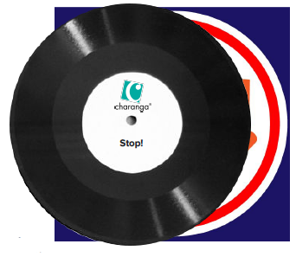
Shirley Heath Stop!| Year 4 | Term: Spring 1
About This Unit
Theme: Grime and other styles of music.
Facts/info: Stop! is a song/rap written in a Grime style for you to compose your own lyrics.
Listen to 5 pieces of music in different styles: ‘Gotta Be Me’ performed by Secret Agent 23 Skidoo (Hip Hop) ‘Radetzky March’ by Strauss (Classical) ‘Can’t Stop The Feeling!’ by Justin Timberlake (Pop with Soul, Funk and Disco influence) ‘Libertango’ by Astor Piazzolla (Tango) ‘Mas Que Nada’ performed by Sergio Mendes and the Black Eyed Peas (Bossa Nova and Hip Hop)
Vocabulary
1. | MUSICAL STYLE | A way of expressing something.
2. | RAP | Rhythmic, rhyming speech.
3. | Lyrics
4. | CHOREOGRAPHY | Designing sequences of movements with your body. It may also refer to the design itself.
5. | Digital / electronic sounds | Electronic music is a genre of music that employs electronic musical instruments, digital instruments, or circuitry-based music technology in its creation.
6. | Turntables | A turntable holds and rotates the record.
7. | Synthesizers | An instrument that uses electricity to make musical sounds.
8. | DRUMS | A drum is a musical instrument that you play by hitting it rhythmically with a stick or your hand.
9. | UNISON | Two or more voices or instruments playing the same note simultaneously.
10. | Pulse | The regular heartbeat of the music; it’s steady beat.
11. | Rhythm | Long and short sounds or patterns that happen over the pulse.
12. | Pitch | High and low sounds.
13. | Tempo | The speed of the music; fast or slow or in-between.
14. | Dynamics | How loud or quiet the music is.
15. | TEXTURE | Layers of sound. Layers of sound working together to make music interesting to listen to.
16. | Structure | The arrangement of a song.
17. | Compose | Writing your own music.
18. | Improvise | Playing notes that are not written for you.
19. | HOOK | A catchy combination of melody, lyrics and rhythm that stays in the listener's head
20. | RIFF | An ostinato; a repeated chord progression, pattern, or melody, often played by rhythmic instruments.
21. | SOLO | A piece or a section of a piece that is played or sung by a single performer.
Listen and Appraise: Stop! (Grime)
Structure: Intro and 6 rapped verses, each with a sung chorus.
Instruments/voices you can hear: Digital/electronic sounds, turntables, synthesizers, drums.
Can you find the pulse as you are listening? Dance, clap, sway, march, be an animal or a pop star.
Musical Activities (Using glocks / recorders)
Compose your own rapped lyrics about bullying or another topic or theme that you decide.

