Slide 1
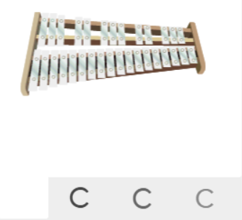
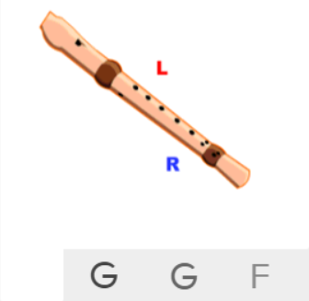
Shirley Heath Lean On Me| Year 4 | Term: Spring 2
About This Unit
Theme: Soul/Gospel music and helping each other.
Facts/info: Lean On Me is a soul song written by Bill Withers in 1972. The song has been covered and interpreted as a Gospel song because of its lyrics.
Listen to 5 other soul/gospel songs: ‘He Still Loves Me’ by Walter Williams and Beyoncé ‘Shackles’ by Mary Mary ‘Amazing Grace’ by Elvis Presley ‘Ode To Joy Symphony No 9’ by Beethoven ‘Lean On Me’ by The ACM Gospel Choir
Vocabulary
1. | UNISON | Two or more voices or instruments playing the same note simultaneously.
2. | BY EAR | The ability of a performing musician to reproduce a piece of music they have heard, without having seen it notated in any form of sheet music.
3. | NOTATION | Methods of writing music.
4. | Improvise | Playing notes that are not written for you.
5. | Melody | The tune.
6. | Pitch | High and low sounds.
7. | Rhythm | Long and short sounds or patterns that happen over the pulse.
8. | Pulse | The regular heartbeat of the music; it’s steady beat.
9. | Composition | Your own music written by yourself.
10. | BACKING VOCAL | A singer who provides vocal harmony with the lead vocalist or other backing vocalists.
11. | PIANO | The piano has the widest range of notes of any instrument, covering more than seven octaves.
12. | BASS | The lowest part of the musical scale. It is also a type of guitar which usually has 4-5 strings.
13. | DRUMS | A drum is a musical instrument that you play by hitting it rhythmically with a stick or your hand.
14. | ORGAN
15. | Tempo | The speed of the music; fast or slow or in-between.
16. | Dynamics | How loud or quiet the music is.
17. | HOOK | A catchy combination of melody, lyrics and rhythm that stays in the listener's head
18. | RIFF | An ostinato; a repeated chord progression, pattern, or melody, often played by rhythmic instruments.
19. | MELODY | The tune.
20. | SOLO | A piece or a section of a piece that is played or sung by a single performer.
Listen and Appraise: Lean On Me (Soul / Gospel)
Structure: Intro, verse 1, chorus, verse 2, bridge, chorus, bridge, verse 3, outro.
Instruments/voices you can hear: Male vocal, backing vocal, piano, bass, drums, organ.
Can you find the pulse as you are listening? Dance, clap, sway, march, be an animal or a pop star.
Musical Activities (Using glocks / recorders)

