Slide 1
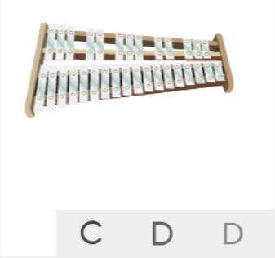
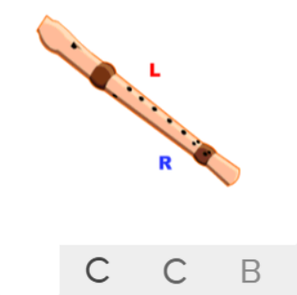
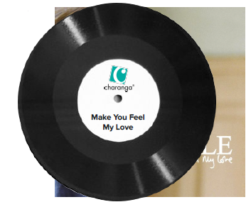
Shirley Heath Make You Feel My Love| Year 5 | Term: Spring 1
About This Unit
Theme: Pop ballads.
Facts/info: Make You Feel My Love is a Pop ballad – a gentle, emotive love song, sung at a slow tempo. It was written by Bob Dylan in 1997 and covered by Adele in 2008.
Listen to 5 other pop ballads ‘Make You Feel My Love’ by Bob Dylan ‘So Amazing’ by Luther Vandross ‘Hello’ by Lionel Ritchie ‘The Way You Look Tonight’ by Tony Bennett ‘Love Me Tender’ by Elvis Presley
Musical Activities (Using glocks / recorders)
Vocabulary
1. | BALLAD | A gentle love song.
2. | VERSE | When two or more sections of the song have almost identical music but different lyrics.
3. | CHORUS | The chorus is designed to be the most memorable section in a song. It often contains a hook or catchy refrain that a listener can easily remember, drawing them back to any individual track.
4. | INTERLUDE | A musical composition inserted between the parts of a longer one.
5. | MELODY | The tune.
6. | Compose | Writing your own music.
7. | Improvise | Playing notes that are not written for you.
8. | COVER | A new performance or recording by a musician other than the original performer or composer of the song.
9. | Pulse | The regular heartbeat of the music; it’s steady beat.
10. | Rhythm | Long and short sounds or patterns that happen over the pulse.
11. | Pitch | High and low sounds.
12. | Tempo | The speed of the music; fast or slow or in-between.
13. | Dynamics | How loud or quiet the music is.
14. | TIMBRE | A musical dimension that describes the quality and character of the sound of the instruments used.
15. | TEXTURE | Layers of sound. Layers of sound working together to make music interesting to listen to.
16. | Structure | The arrangement of a song.
Listen and Appraise: Make You Feel My Love (Pop)
Structure: Piano intro, verse 1, verse 2, chorus, verse 3, interlude, chorus, verse 4 with tag ending.
Instruments/voices you can hear: Strings, piano, guitar, bass, drums.
Can you find the pulse as you are listening? Is the tempo fast, slow or in-between? Dynamics? Texture?

