Slide 1
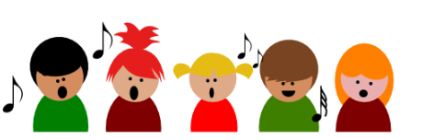
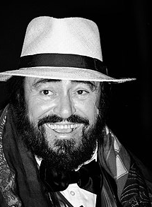
Shirley Heath Easter at St. James’ Church | Year 5 | Term: Spring 2
Engage the Body
Posture Be aware of my posture – STAND TALL. Ahhhh…. Relax! Singers can feel tension in their shoulders and neck which does not help the body produce a good sound. Scrunch up the shoulders towards the ears and release. Gently roll shoulders in big circles. Stretching is a good way to move the rib cage and muscles at the side. Reaching both arms in to the air above your head and down again will achieve this movement. Breathing We need to have an awareness on how to maximise breathing whilst singing. We need to think about controlling our airflow - little breath may mean less power and life in sustaining our notes. Too much air rushing out will result in a loss of control and life in our notes. Talking a breath before singing a note should not take place as a big gasp, but a breath that uses the bottom of our lungs, the side of our ribcage and round our back. Imagining there is an inflatable tyre ring round our body or filling with air from the bottom up may help with this. The face Pull as many funny faces as you can, screwing up the muscles and opening up to a wider expression. Focus on the mouth. Chewing imaginary chewing gum and poking your tongue out to wiggle it around also moves the jaw and tongue around in the right places. The most important thing is…. Don’t worry about what you look like. The more ridiculous, the better!
Vocabulary
1. | PULSE | The heart beat that runs throughout a piece of music.
2. | RHYTHM | Syllables from lyrics, singing long and short notes.
3. | PITCH | Melody which consists of singing high and low.
4. | TEMPO | The speed of a song (how fast or slow it is).
5. | SOLFA | Pitch names such as Do, Re, Me, Fa, So.
6. | DYNAMICS | Volume of the voice.
Iconic Singer – Luciano Pavarotti
This Italian superstar tenor had an instantly recognizable voice. His high notes seemed so easy that his nickname was “King of the High Cs”! Luciano Pavarotti was born on 12th October 1935 and died on 6th September 2007. He was an Italian operatic tenor who also crossed over into popular music, eventually becoming one of the most commercially successful tenors of all time.

