Slide 1
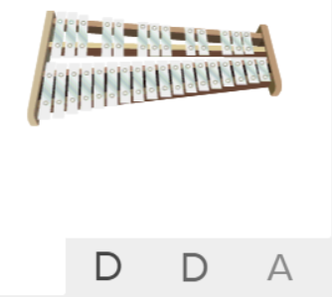
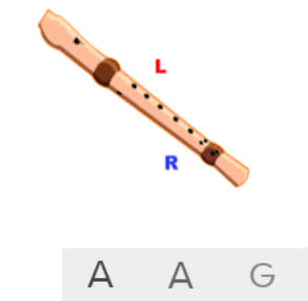
Shirley Heath The Fresh Prince of Bel-Air| Year 5 | Term: Spring 2
About This Unit
Theme: Old-school Hip Hop.
Facts/info: The Fresh Prince of Bel-Air was written and performed by Will Smith in 1990 for a television series of the same name. The music and show were written by Quincy Jones.
Listen to 5 other hip hop songs: ‘Me Myself and I’ by De La Soul ‘Ready or Not’ by Fugees ‘Rapper’s Delight’ by The Sugarhill Gang ‘U Can’t Touch This’ by MC Hammer ‘It’s Like That’ by Run DMC
Vocabulary
1. | HIP HOP | Music that developed in the 1970s but remains popular today. It includes rapping.
2. | RAP | A vocal technique in which the performer speaks rhythmically against a steady beat.
3. | RIFF | An ostinato; a repeated chord progression, pattern, or melody, often played by rhythmic instruments.
4. | SYNTHESIZER | An instrument that uses electricity to make musical sounds.
5. | DECK | A device on which vinyl records can be played, in order to listen to the music or other sounds on them
6. | BACKING LOOPS | A repeating section of sound material (loop) played in the background.
7. | FUNK | Music with strong bass lines and a heavy syncopated beat.
8. | SCRATCHING | A DJ and turntablist technique of moving a vinyl record back and forth on a turntable to produce percussive or rhythmic sounds.
9. | UNISON | Everyone plays or sings the same music at the same time.
10. | MELODY | The tune.
11. | Compose | Writing your own music.
12. | Improvise | Playing notes that are not written for you.
13. | COVER
14. | Pulse | The regular heartbeat of the music; it’s steady beat.
15. | Rhythm | Long and short sounds or patterns that happen over the pulse.
16. | Pitch | High and low sounds.
17. | Tempo | The speed of the music; fast or slow or in-between.
18. | Dynamics | How loud or quiet the music is.
19. | TIMBRE | A musical dimension that describes the quality and character of the sound of the instruments used.
20. | TEXTURE | Layers of sound working together to make music interesting to listen to.
Listen and Appraise: The Fresh Prince of Bel-Air (Hip Hop)
Structure: Piano intro, verse 1, verse 2, chorus, verse 3, interlude, chorus, verse 4 with tag ending
Instruments/sounds you can hear: Loops, samples, decks, scratching, drums, bass, synthesizer, rapper.
Can you find the pulse as you are listening? Is the tempo fast, slow or in-between? Dynamics? Texture?
Musical Activities (Using glocks / recorders)

