Slide 1
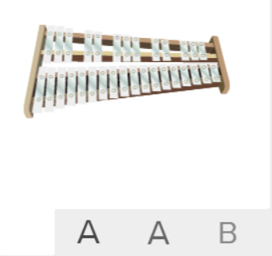
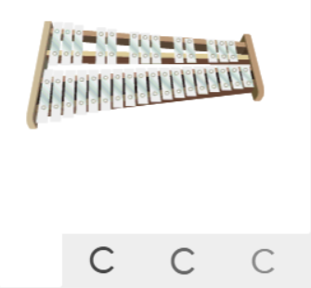
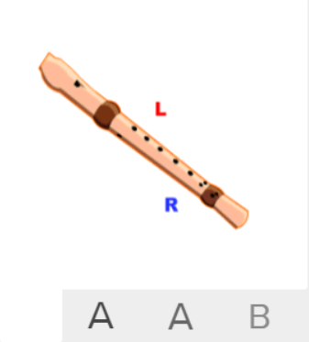

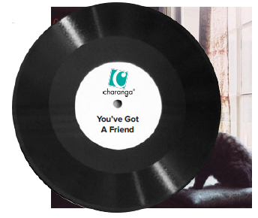
Shirley Heath You’ve Got A Friend In Me| Year 6 | Term: Spring 2
About This Unit
Theme: The music of Carole King.
Facts/info: You've Got A Friend was a song written by Carole King in 1971. It was first recorded by Carole and featured on her famous album, Tapestry. In the 1960s, Carole King was employed to write pop songs for artists to perform.
Listen to 5 other songs written by Carole KIng: ‘The Loco-Motion’ sung by Little Eva ‘One Fine Day’ sung by The Chiffons ‘Up On The Roof’ sung by The Drifters ‘Will You Still Love Me Tomorrow’ ‘(You Make Me Feel Like) A Natural Woman’ sung by Carole King
Musical Activities (Using glocks / recorders)
Easy part
Medium part
Easy part
Medium part
Vocabulary
1. | MELODY | The tune.
2. | Compose | Writing your own music.
3. | Improvise | Playing notes that are not written for you.
4. | COVER | A cover song is a new performance or recording of a previously recorded song by someone other than the original artist or composer.
5. | Pulse | The regular heartbeat of the music; it’s steady beat.
6. | Rhythm | Long and short sounds or patterns that happen over the pulse.
7. | Pitch | High and low sounds.
8. | Tempo | The speed of the music; fast or slow or in-between.
9. | Dynamics | How loud or quiet the music is.
10. | TIMBRE | A musical dimension that describes the quality and character of the sound of the instruments used.
11. | TEXTURE | Layers of sound. Layers of sound working together to make music interesting to listen to.
12. | STRUCTURE | How the sections (verses and choruses etc.) of a song are ordered to make the whole piece.
13. | HOOK | A hook is a musical idea, often a short riff, passage, or phrase, that is used in popular music to make a song appealing and to "catch the ear of the listener".
14. | RIFF | A riff in music, a riff is a repeated sequence of notes or chords.
15. | SOLO | A piece or a section of a piece that is played or sung by a single performer.
16. | UNISON | Everyone plays or sings the same music at the same time.
17. | HARMONY | Different notes sung or played at the same time to produce chords.
Listen and Appraise: You’ve Got A Friend In Me (the music of Carole King)
What style indicators can you hear?
Describe the structure?
What instruments/voices you can hear?
Describe the musical dimensions?

