Slide 1
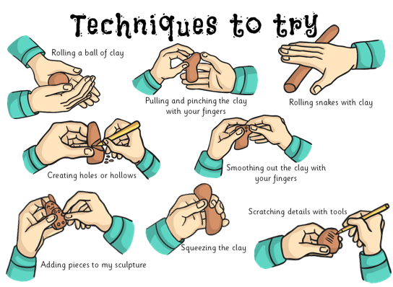
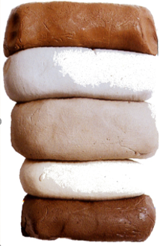
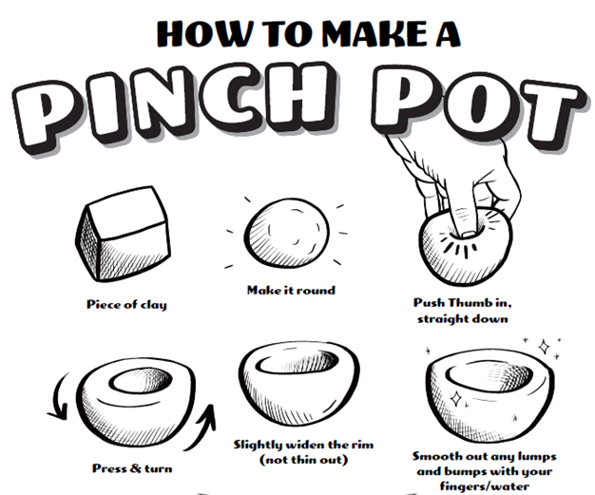
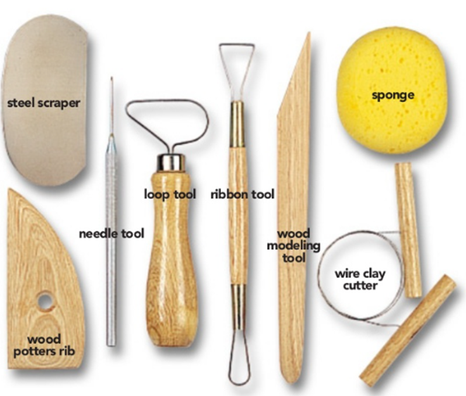
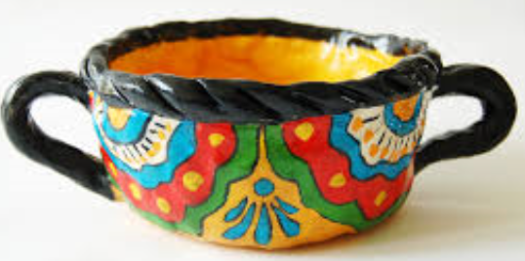
Shirley Heath Sculpting| Year 3 | Term: Spring
Clay techniques
Types of clay
Vocabulary
1 | Slip | Liquid clay a runny as heavy cream, used to create a bond between two of clay.
2 | Glaze | Liquid glass that is used to paint on and is fired until glassy.
3 | Score | Roughen up surface of raw clay so two clay pieces stick to each other.
4 | Pinch | Clay squeezed between fingers for form pot.
5 | Coil | Clay rolled into snake-like pieces of even thickness.
6 | Slab | A flat ‘pancake’ of clay made with your hands on a rolling pin.
7 | Kiln | Special oven that gets super hot to turn clay into ceramic (fire the clay).
8 | Ceramic | The word for fired clay.
9 | Pottery | A ceramic container like a mug.
Red clay
Bone China clay
Stoneware &
Earthenware clay
Porcelain clay
Black clay
How to make a …
Tools

