Slide 1
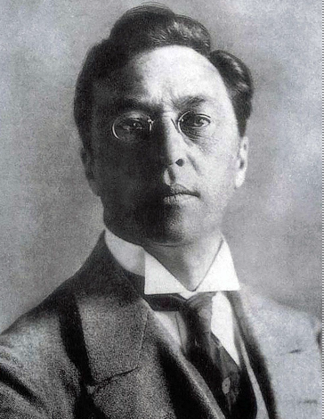
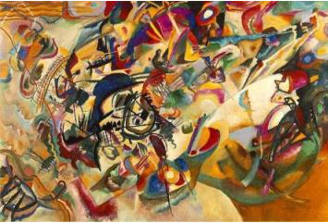
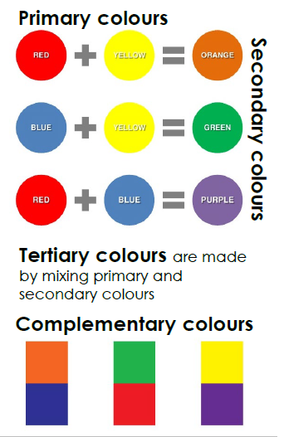
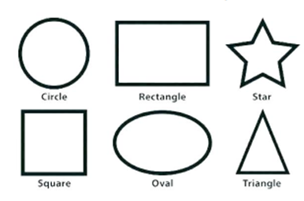
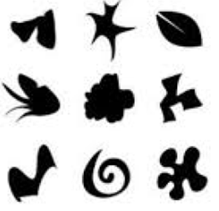
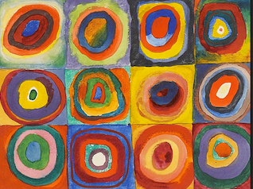
Shirley Heath Painting: Kandinsky | Year 4 | Term: Spring
Wassily Kandinsky
Elements of Art: Colour
Vocabulary
1 | Primary colours (red, yellow, blue) | Three colours of the spectrum from which all other colours can be made by mixing.
2 | Secondary colours (green, purple, orange) | A colour achieved from the mixing of two primary colours.
3 | Tertiary colours | When an equal amount of a primary and a secondary colour are mixed.
4 | Complementary colours | Opposite hues on the colour wheel - one primary colour and the secondary colour that is created by mixing the other two primaries.
5 | Contrasting colours | Two colours from different segments of the colour wheel eg: red is from the warm half of the colour wheel and blue is from the cool half.
6 | Tint | Tints describe the "Presence of Light" within a hue. They are created by slowly adding white to a hue when mixing your colours to create a lighter hue of that colour.
7 | Shade | Shades describe the "Absence of Light" within a hue. Shades are created by slowly adding black to a hue, when mixing your colours. Shades create a darker hue of colour.
8 | Hue | Another word for colour. Colour is described by hue.
9 | Tone | This refers to the lightness or darkness of colors used.
Composition V11
Who is he and what is he famous for?
He was a Russian painter and artist, born 1866 - died 1944. He is known as the founder of abstract art. He is best known for his paintings titled “composition” as he considered these 10 to be the best.
What inspired him?
He first painted landscapes but then decided paintings didn’t need a particular subject. He believed he could express feeling and music through colours and shapes and that alone could be art.
Abstract Art Movement
It took place in the United States. Abstract Art has no subject. It is just lines, shapes, and colours. The Abstract Art movement is called Abstract Expressionism because, although the art has no subject, it is still trying to convey some kind of emotion.
Elements of art: Shape
Geometric Shapes
Organic Shapes

