Slide 1
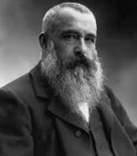
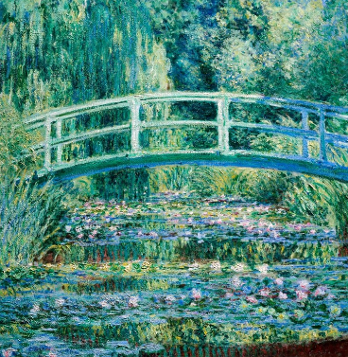
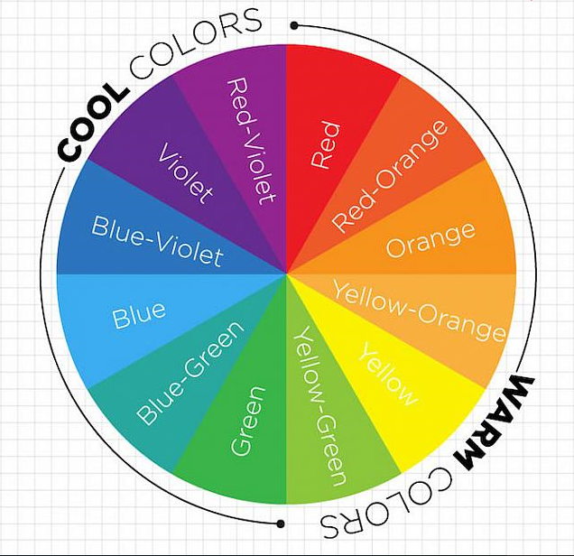
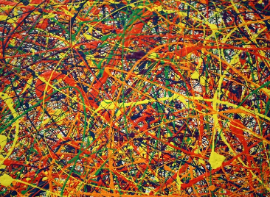
Shirley Heath Painting: Claude Monet | Year 5 | Term: Spring
Claude Monet
Elements of Art: Colour
Vocabulary
1 | Primary colours (red, yellow, blue) | Three colours of the spectrum from which all other colours can be made by mixing.
2 | Secondary colours (green, purple, orange) | A colour achieved from the mixing of two primary colours.
3 | Tertiary colours | When an equal amount of a primary and a secondary colour are mixed.
4 | Complementary colours | Opposite hues on the colour wheel - one primary colour and the secondary colour that is created by mixing the other two primaries.
5 | Contrasting colours | Two colours from different segments of the colour wheel eg: red is from the warm half of the colour wheel and blue is from the cool half.
6 | Warm colours | Such as red, yellow, and orange; evoke (brings to mind) warmth because they remind us of things like the sun or fire.
7 | Cold colours | Such as blue, green, and purple (violet); evoke a cool feeling because they remind us of things like water or grass.
8 | Texture | Texture is the perceived surface quality of a work of art.
9 | Pointillism | Small dots of colour are used to make an image.
10 | Action painting | When paint is thrown at a large canvas (Jackson Pollock).
Who is he and what is he famous for?
He was a French artist born 1840- died 1926.
He is most famous for his waterlilies series which he painted using very loose brushstrokes.
What inspired him?
His water garden at his house in Giverny, France. These pictures are called abstract-impressionist paintings because the surface of the pond fills the entire canvas with light and colour and the image looks almost abstract.
Elements of Art: Texture
There are many different kinds of paint and each one gives a different finish or effect. The strength and thickness of paint, the way it is applied and what is added to it such as water, glue, sand and sawdust, gives the desired effect to the painters work. Below: Jackson Pollock’s Conformity
Impressionist Art Movement
Impressionism is a style of painting that began in France in the early 1860s when artists started painting pictures outside, rather than in their studios. This was called 'en plein air' (which is French for open air). They wanted to capture moments in time. Because the light conditions kept changing, they had to work very quickly, using quick, gestural brushstrokes of paint.

