Slide 1
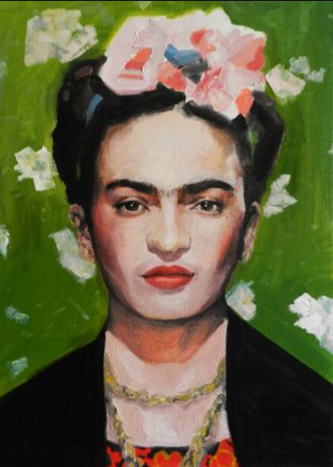
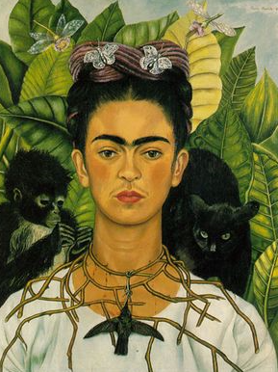
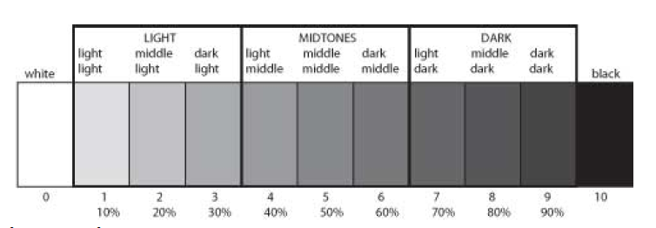
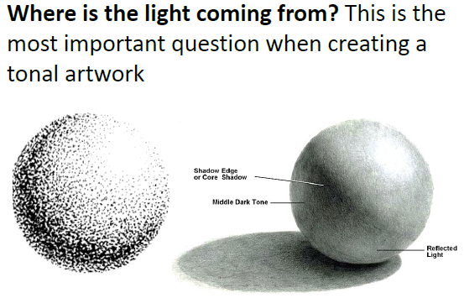
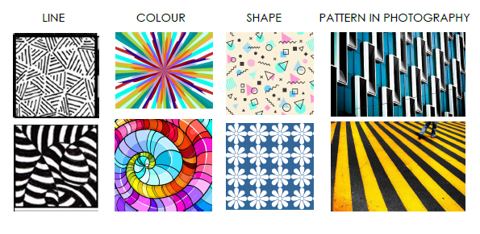
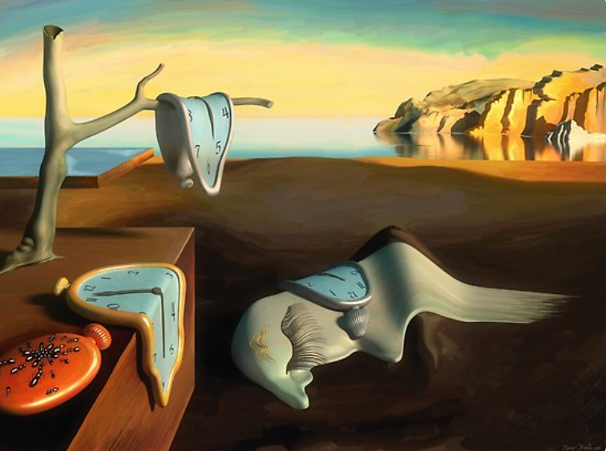
Shirley Heath Painting: South American Art | Year 6 | Term: Spring
Freda Khalo
Elements of Art: Tone
Vocabulary
1 | Contrast | The arrangement of opposite elements (light vs. dark colors, rough vs. smooth textures, large vs. small shapes, etc.) in a piece so as to create visual interest, excitement and drama.
2 | Emphasis | The significance or importance given to an element.58765
3 | Movement | Visual flow through the composition
4 | Rhythm | The repeating of oun or several elements to create movements.
5 | Motif | is an element of an image. A motif may be repeated in a pattern or design, often many times, or may just occur once in a work.
6 | Symmetry | Symmetry in art is when the elements of a painting or drawing balance each other out. This could be the objects themselves, but it can also relate to colours and other compositional techniques
7 | Asymmetrical | Two sides don't match; the two sides are different in some way.
Who is she and what is she famous for?
She is a Mexican painter born July 1907 – 1954. She is known for her surreal and very personal works. She was disabled and had studied medicine in order to become a doctor.
What inspired her?
When she was 18 she was involved in an accident and suffered from severe pain for the rest of her life. This inspired her to paint her painful life and the harsh lives of women.
Elements of Pattern:
Surrealist Art Movement
Surrealism was an art and cultural movement which began in 1920. Surrealist works have an element of surprise: unexpected items are placed next to each other for no clear reason. Left: Salvador Dahli, The Persistence of Memory, 1931

