Slide 1
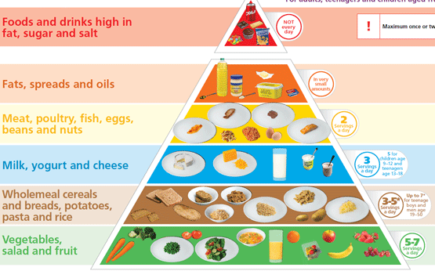
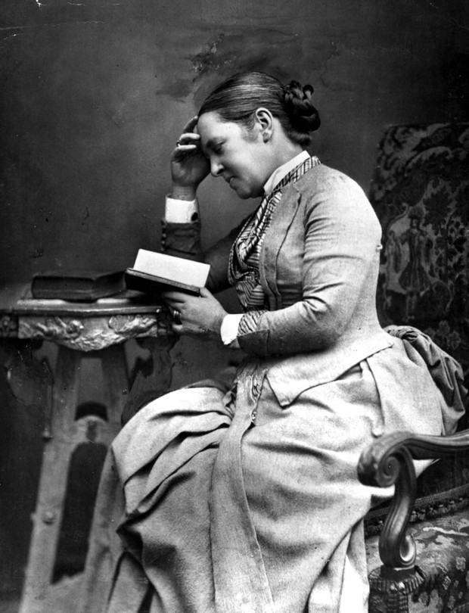
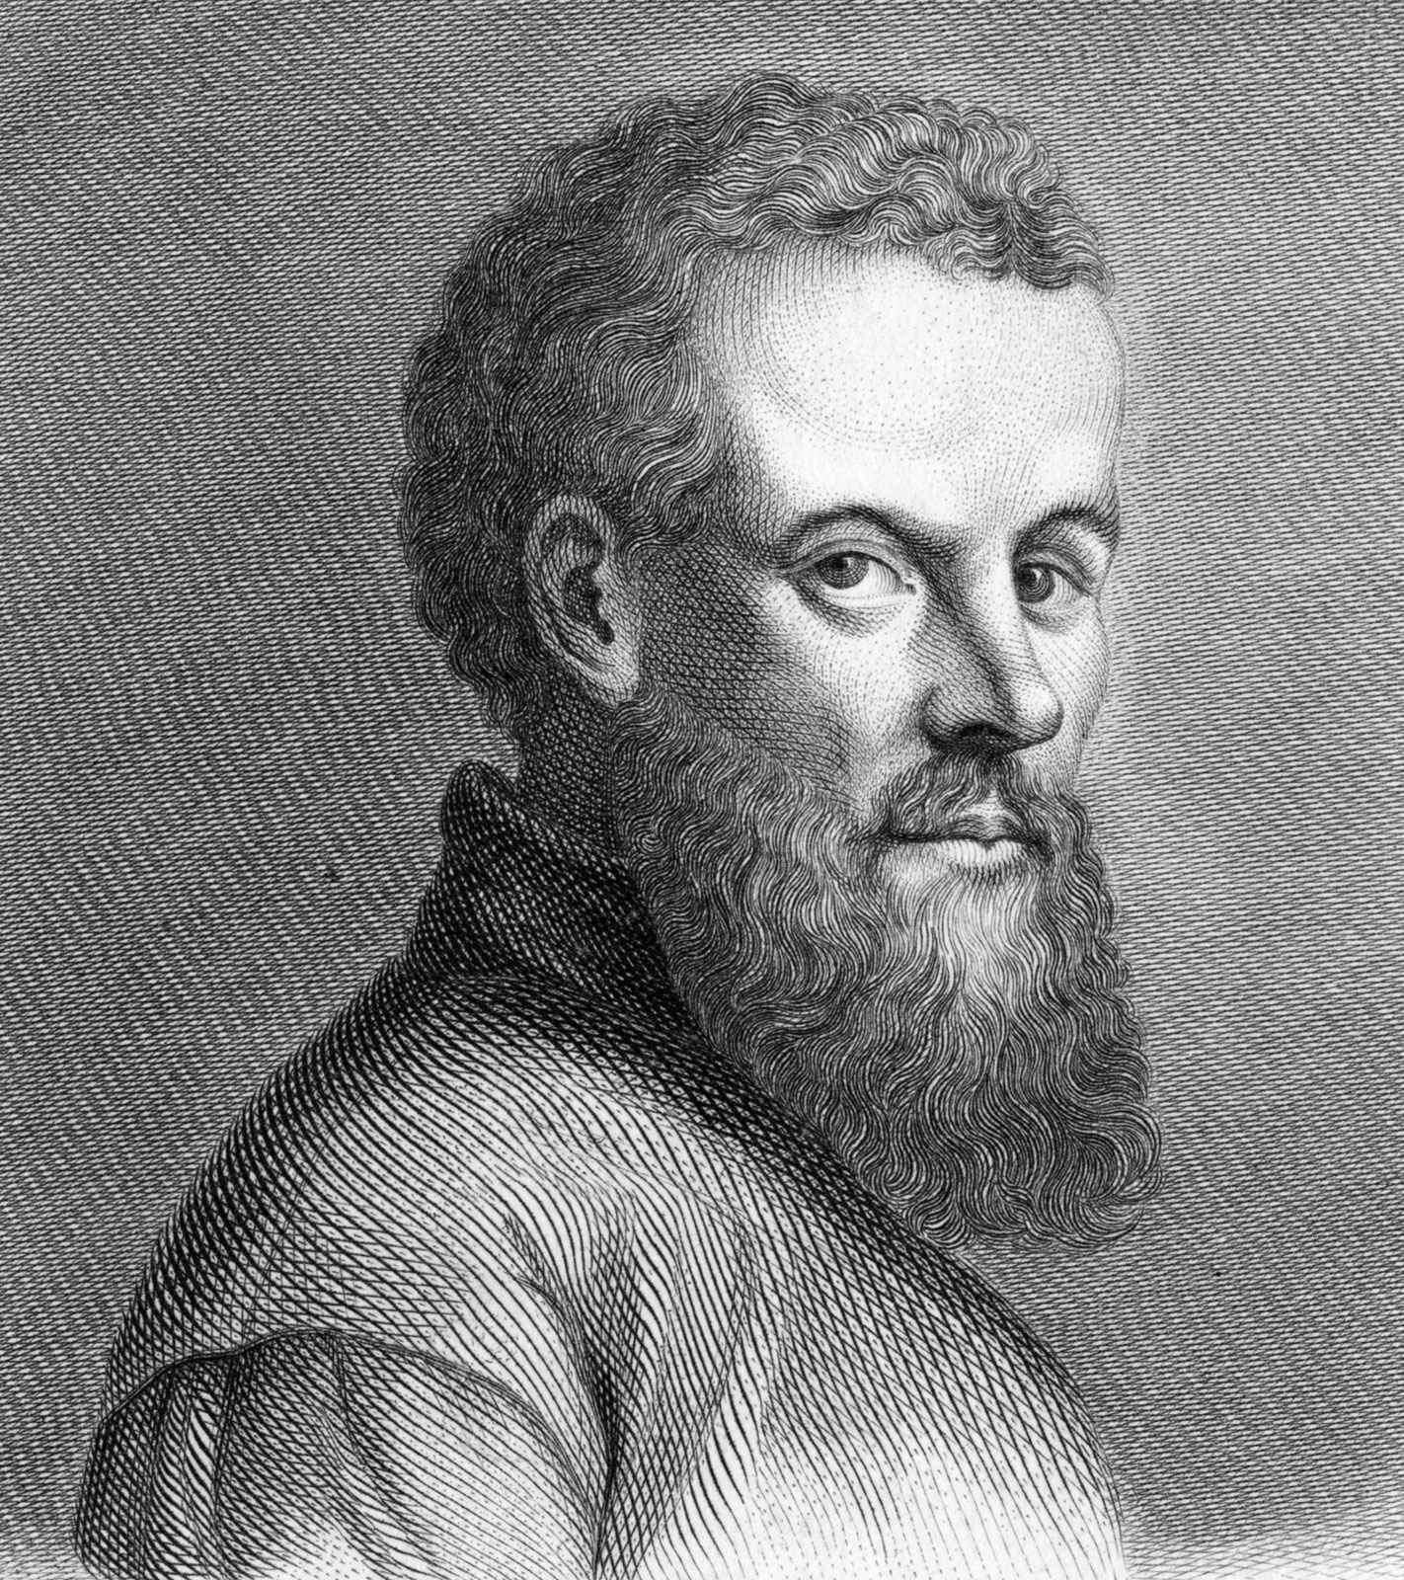
Shirley Heath ‘Your Body: Inside and Out’ Body Structure (Human Biology) | Year 3 | Spring 1
Key Knowledge
1 | Animals (including humans) cannot make their own food. They receive their nutrition from what they eat.
2 | The main food groups are: Carbohydrates: source of energy Protein: for growth and repair Fats: energy storage Vitamins and Minerals: to fight infections and keep the body healthy Water: Almost all of the body’s activities require water
3 | Owl pellets contain the undigested remains of the owl’s food (bones). An owl usually regurgitates (coughs up) 1-2 pellets each day.
4 | Joints connect bones and mean we can bend, twist and jump. Joints include ball and socket, hinge and gliding joints
5 | Bones can be used to support the body but can also be used to protect vital organs. The rib cage and sternum protect the heart and lungs and the skull protects the brain
Key Diagrams
Key Vocabulary
1 | Vertebrates | Animals with a backbone
2 | Invertebrates | Animals without a backbone
3 | Skeleton | The role of the skeleton is to support and protect the body
4 | Muscle | The parts of the body that enable movement and support to the skeleton
5 | Nutrition | Having the right combination of carbohydrate, protein, fat and vitamins in your diet
6 | Carnivores | Animals that only eat meat
7 | Herbivores | Animals that only eat plants
8 | Omnivores | Animals that eat a combination of meat and plants
9 | Endoskeleton | An internal skeleton (inside the animal). All vertebrates have an endoskeleton
10 | Exoskeleton | A skeleton that supports and protects the animal on the outside of the body (e.g. a beetle's shell)
11 | Hydrostatic skeletons | A flexible skeleton supported by water pressure (simple invertebrates e.g. slugs)
The food pyramid shows how much of each food group you should have in your diet
Important Scientist
1 2 | Elizabeth Garrett Anderson (1836-1917) First female doctor in England Andreas Vesalius (1514-1564) The father of anatomy

