Slide 1
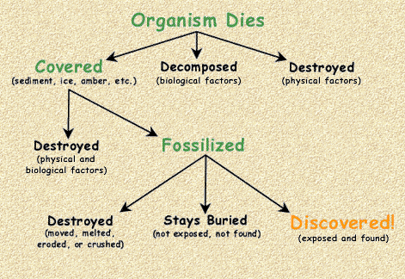

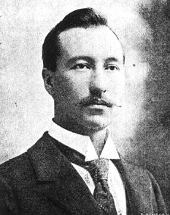
Shirley Heath How would it feel to discover a dinosaur?-Rocks (Chemistry) | Year 3 | Spring 2
Key Knowledge
1 | Natural rocks include: Igneous Sedimentary Metamorphic
2 | Man-made rocks include: Bricks Mock rocks Concrete
3 | How do igneous rocks form? - Magma (molten rock) cools to form hard rock containing crystals
4 | How do sedimentary rocks form? - Rock builds up in layers on the sea floor over time which are then squashed into layers of soft rock
5 | How do metamorphic rocks form? - Rock which changes shape and hardens deep below the surface of the Earth.
Key Diagrams
Why are fossils tricky to find?
Key Vocabulary
1 | Hardness | A measurement of how hard or soft a rock is.
2 | Permeability | A measurement of how easily water can pass through a rock
3 | Appearance | How the rock looks. For example: shiny, dull, smooth, rough, colourful, plain
4 | Fossils | Remains of an animal or plant, covered by layers of mud and soil and hardened by sediment over millions of years
7 | Soil | A mixture of organic remains, clay and rock particles
8 | Intrusive Igneous Rock | Magma which has cooled slowly below the Earth’s surface (large crystals)
9 | Extrusive Igneous Rock | Magma which has cooled quickly above the Earth’s surface (small crystals)
Important Scientists
1 | Mary Anning (1799-1847) Famous fossil hunter who discovered several new aquatic dinosaurs
2 | Barnum Brown (1872-1963) Discovered the first partial skeleton of a Tyrannosaurus Rex in 1902

