Slide 1
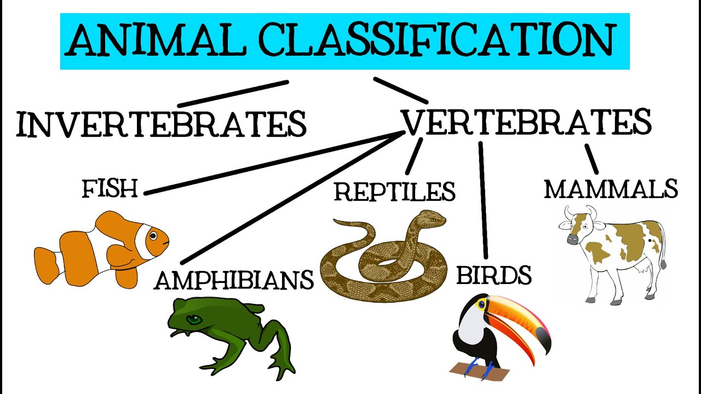
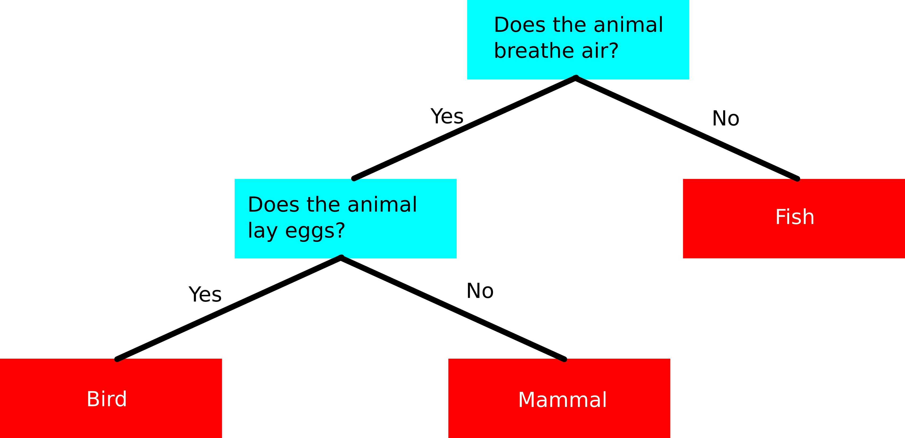
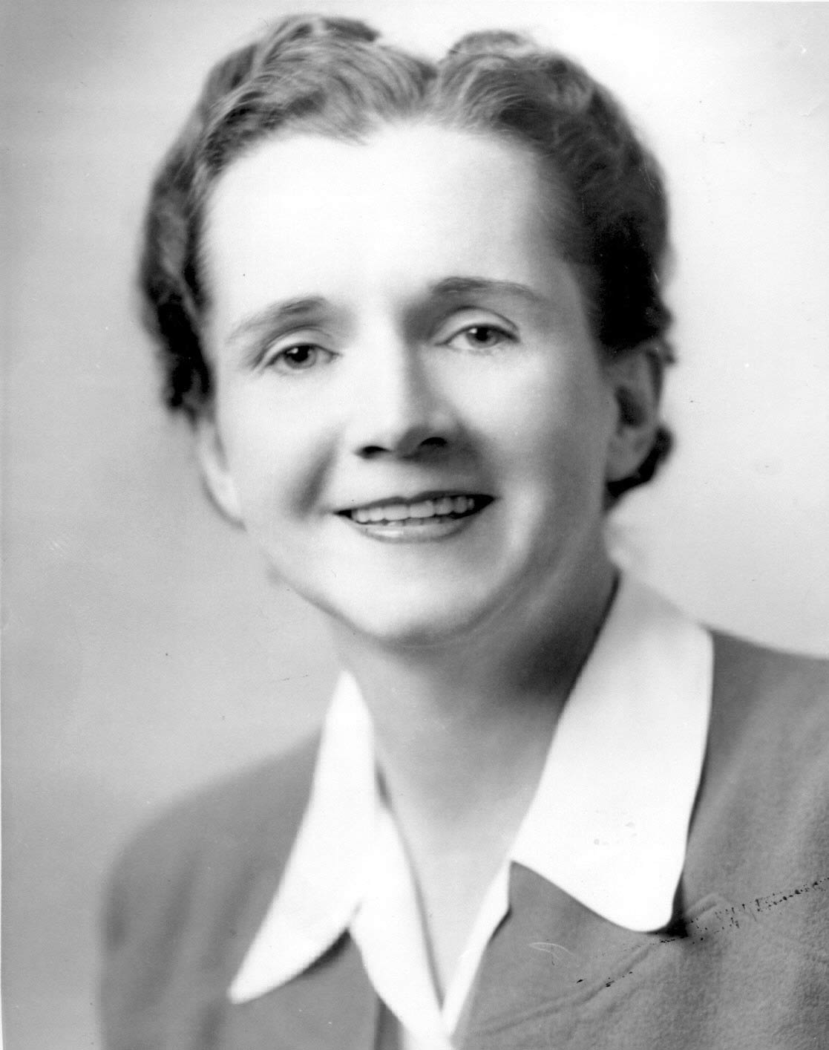
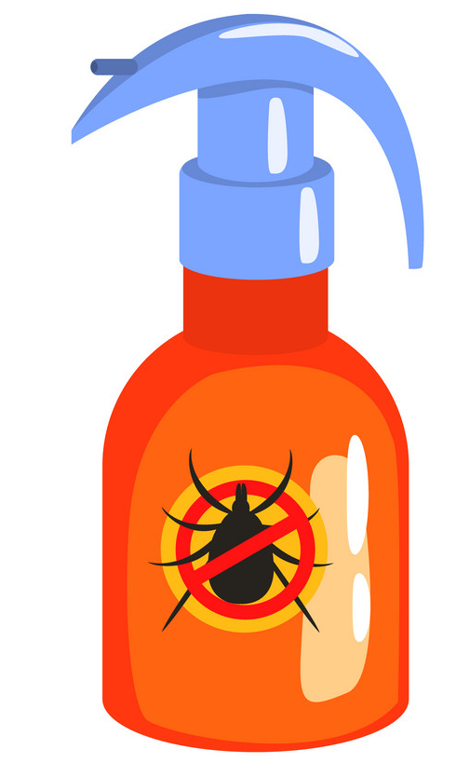
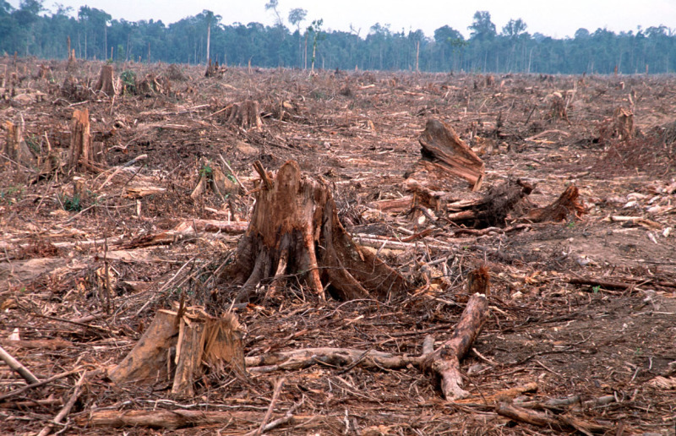
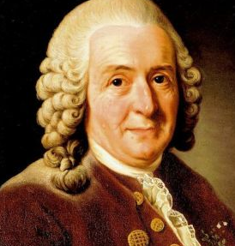
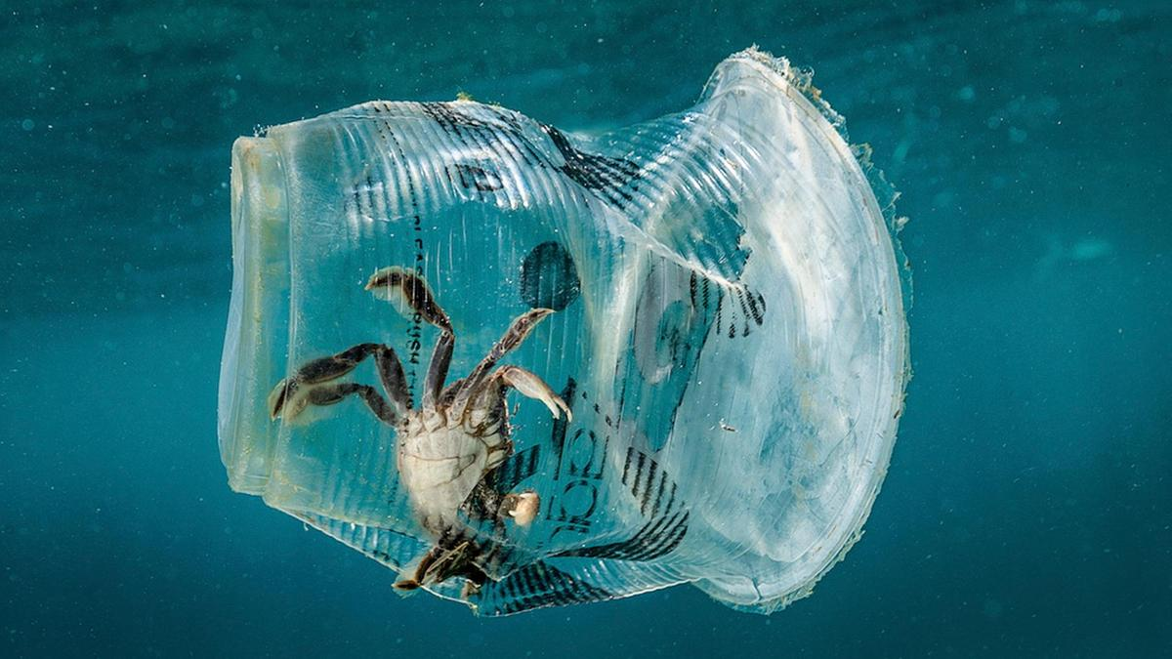
Shirley Heath ‘There’s a world out there’ Classification and Environments (Biology)| Year 4 | Spring 1
Key Knowledge
1 | Classification is when living things are put into categories based on how they look, how they behave and sometimes on what their code (DNA) looks like inside their bodies.
2 | Vertebrates are grouped into 5 different ‘classes’. These are Mammals, Birds, Fish, Amphibians and Reptiles
3 | Invertebrates include classes such as arthropods (insects and spiders), molluscs (octopuses, snails, slugs) and echinoderms (star fish)
Key Diagrams
Key Vocabulary
1 | Organism | Any living thing that carries out the processes of life (feeding, using energy, producing waste)
2 | Species | A groups of organisms that share the same features and are capable of producing offspring (babies).
3 | Habitat | The particular place where an organism lives
4 | Environment | An area usually including several habitats where organisms live and interact with each other
5 | Vertebrates | Animals with a spine (backbone)
6 | Invertebrates | Animals without a spine (backbone)
7 | Flowering plants | A plant which produces flowers as part of its reproductive cycle
8 | Non-flowering plants | A plant which does not produce flowers as part of its reproductive cycle but which will still produce seeds
9 | Human impact on the environment (positive) | Creating nature reserves as safe places for wildlife, protecting hedgerow habitats, setting up garden ponds
10 | Human impact on the environment (negative) | Building houses, litter, deforestation, using pesticides on farmland, dumping waste and plastic into rivers and oceans.
Example of a classification key
Important Scientists
1 | Rachel Carson (1907-1964) | Author of ‘Silent Spring’ a book about the impact of pesticides on the environment
2 | Carl Linnaeus (1707-1778) | Designed the modern way in which we group living things into categories
Threats to habitats

