Slide 1
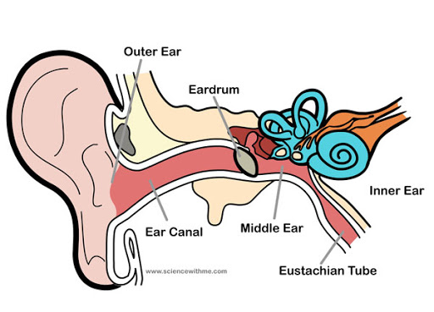
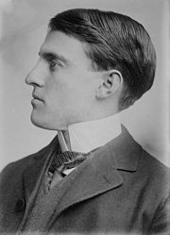
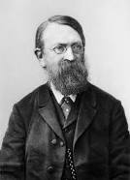
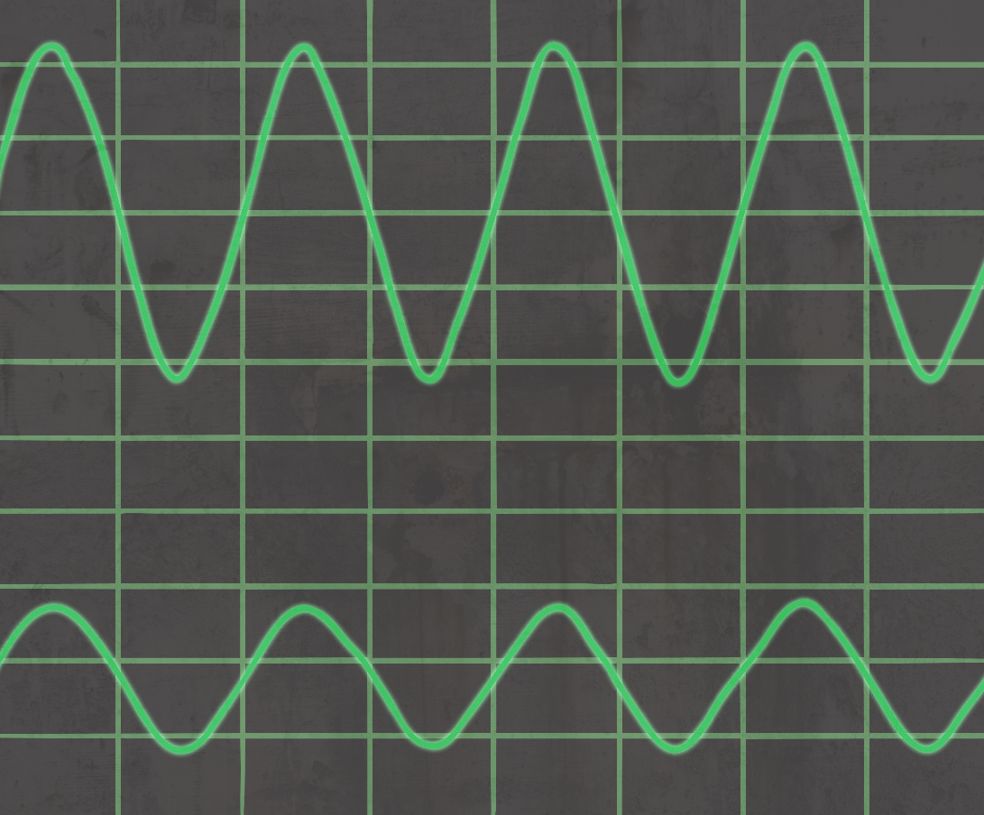
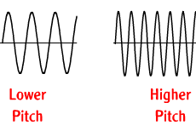
Shirley Heath What’s so good about Vibrations? –Sound (Physics) | Year 4 | Spring 2
Key Knowledge
1 | Vibrations - Sounds are created when objects vibrate. The movement energy is transferred to sound energy
2 | Pitch - How high or low the sound is based on how close together the vibrations of the sound wave are
3 | Volume (Amplitude) - The size of the vibration is called the amplitude. A larger amplitude make a louder sound.
4 | Sounds are transmitted to the brain by nerve endings in the inner ear. These nerve endings can be damaged by loud noises which is permanent
5 | Sounds through solids, liquids and gases - Sounds travel quickest in solids, then liquids, then gases. This is because sounds travel better when the particles are closer together
Key Diagrams
Important Scientists
1 | Miller Reece Hutchinson (1876-1944) Designed the first hearing aid in 1898
2 | Ernst Mach (1838-1916) The ‘Mach’ measurement for jet fighters is named after this sound scientist
Higher Amplitude means a louder sound
If the vibrations are closer together then the pitch of the sound is higher

