Slide 1
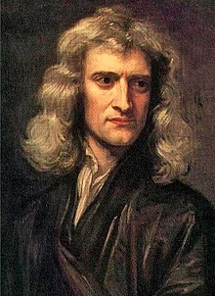
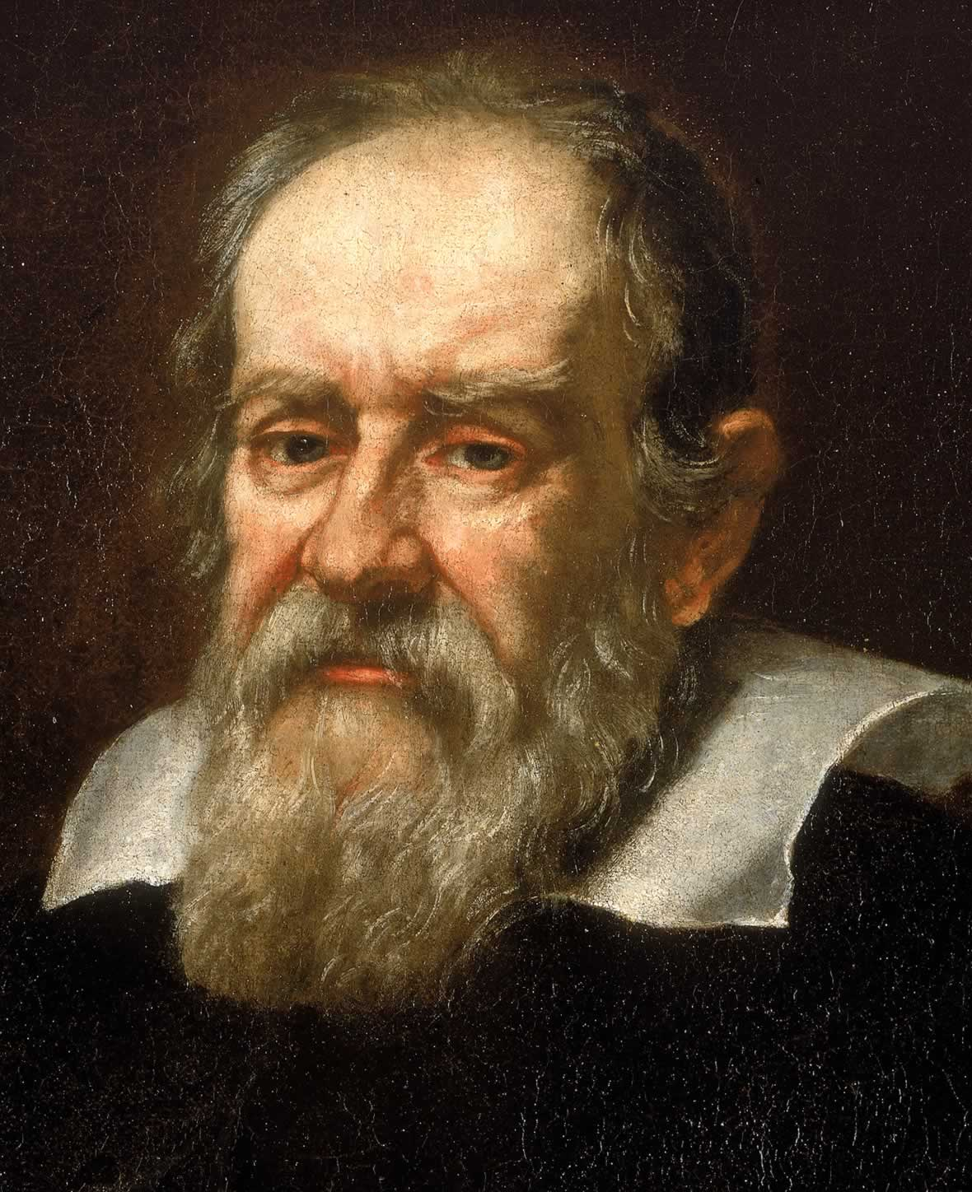
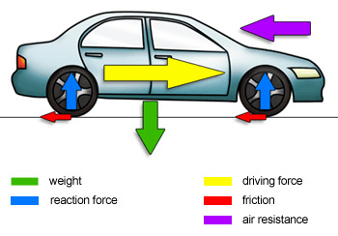
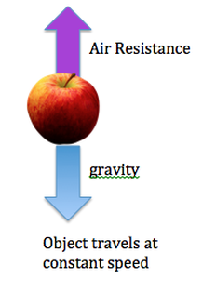
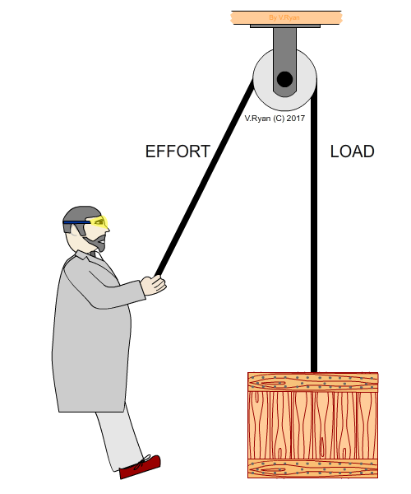
Shirley Heath ‘Can you defy gravity?’ Physics (Forces) | Year 5 | Spring 1
Key Knowledge
1 | Gravity: An unsupported object falls towards the Earth because of the force of gravity acting between the Earth and the falling object
2 | Air Resistance: The force created by air particles colliding with a moving object (works against the driving force) It can also be the force acting against gravity as an object falls to the ground.
3 | Why do we float on water? Water creates an up-thrust force called buoyancy which means your body weight is reduced by 90%. This means that when you lie on the surface of water you are much lighter because of the upward force from the water and then therefore float
4 | How do parachutes work? When a sky diver starts to fall from the plane gravity pulls them towards the ground. When they open their parachute this massively increases their air resistance as lots of air is trapped in the parachute. This slows them down until they reach a steady speed where the force of gravity and the force of air resistance are equal.
Key Vocabulary
1 | Mass | What an object is made of and how much space it takes up. Measured in grams (g)
2 | Weight | The effect of gravity on the mass of an object (measured in Newtons)
3 | Gravity | An attractive force between objects
4 | Driving Force (Thrust) | The force driving an object forward
5 | Friction | The force created between two surfaces which works against the driving force
6 | Air Resistance | The force created by air particles colliding with a moving object.
7 | Water Resistance | A form of friction which acts against objects moving through water
8 | Lever | A bar resting on a pivot which can be used to move a heavy load when pressure is applied to one end
9 | Pulleys | A wheel with a grooved rim around which a cord passes. It changes the direction of the force which is applied and can be used to lift heavy objects
10 | Gears | A toothed wheel which can be used to alter the speed of a driving mechanism.
Important Scientists
1 | Isaac Newton (1643-1727)
2 | Galileo Galilei (1564-1642)
Key Diagrams

