Slide 1
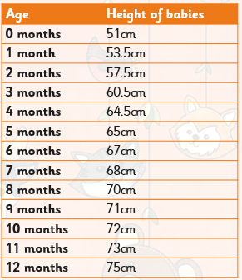
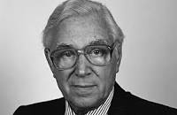
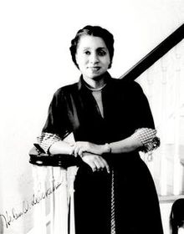
Shirley Heath Human Biology (Growth and Development)| Year 5 | Spring 2
Key Vocabulary
1 | Asexual Reproduction - When an organism copies its DNA and produce offspring which is a exact copy of the parent
2 | Sexual Reproduction - When DNA from two parents is mixed to create a new organism which will be similar to their parents but unique
3 | Prenatal - This is the stage before birth. It is from the time of fertilisation when sperm meets egg until birth
4 | Baby-Toddler (0-3 years) - A period of rapid growth in all four areas of growth. A baby is entirely dependent on its parents to survive
5 | Child-Adolescent (3-18 years) - A period of sustained growth. During this time puberty results in changes to the body. These changes enable reproduction in early adulthood
6 | Early- Mid Adulthood (18-59 years) - The human body is at its peak fitness and strength. This is the age when most humans reproduce.
7 | Late Adulthood- Old age (60+) - This is the last stage of human development
Key Diagrams
Key Knowledge
1 | Human growth can occur in 4 ways: Physical, Emotional, Psychological, Social
2 | Changes in Middle Age: (40-59 years old) Ability to reproduce declines Women experience menopause in 40s and 50s when they no longer produce eggs
3 | Changes in Old Age (60+) No development in growth but mental development is still possible The body declines in fitness and health Some older people can become more fragile physically and may need more support
4 | Life Expectancy and Gestation periods - Life expectancy is the length of time, on average, that a particular animal is expected to live. Gestation is how long they develop for before birth.
Important Scientists
1 | Patrick Steptoe (1913- 1988) Developed the first IVF treatment
2 | Helen Octavia Dickens (1909-2001) First African-American woman to be admitted into the American College of Surgeons

