Slide 1
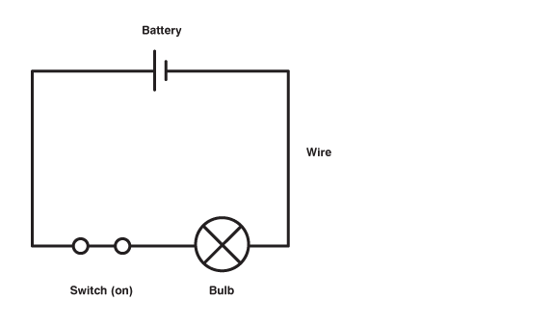
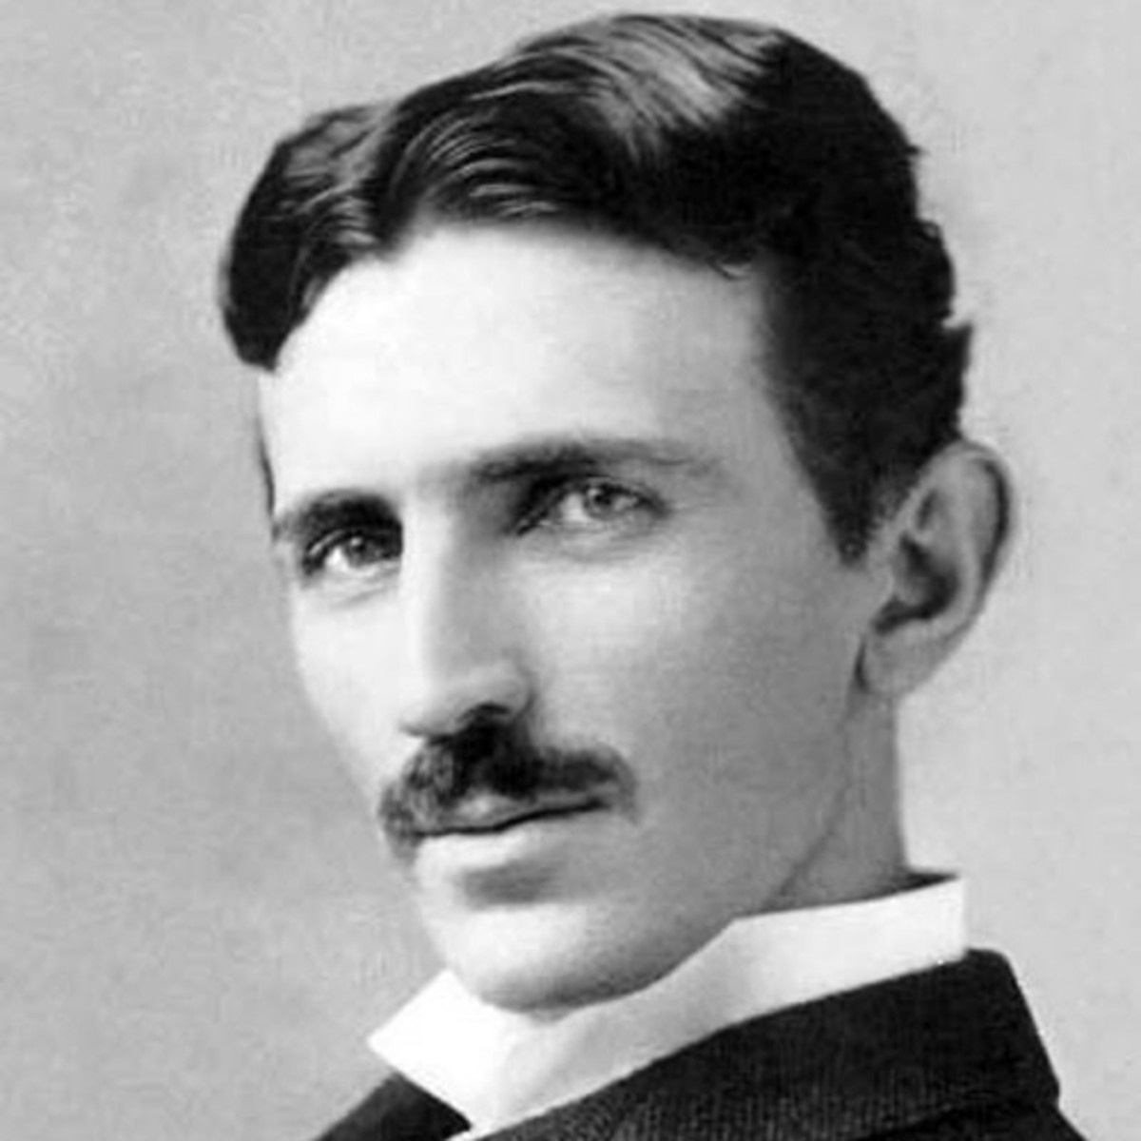
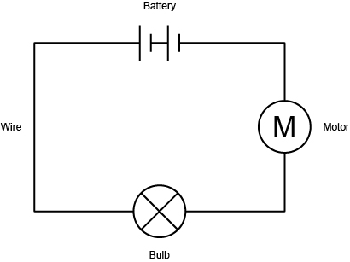
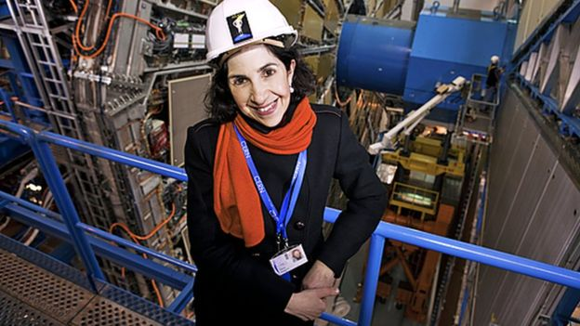
Shirley Heath ‘Is Resistance futile?’ Electricity (Physics) | Year 6 | Spring 1
Key Diagrams
Key Knowledge
1 | Voltage: The pushing force which pushes electricity around the circuit from the cell/battery. Sometimes called potential difference and measured in Volts (V)
2 | Current: A measurement of the flow of electricity. Think of it as the speed of the electrons as they move around the circuit. Current is measured in Amps (A)
3 | Resistance: This is a name given for anything in a circuit that opposes the flow of electricity. This could be achieved through using a fixed resistor or a component where the resistance can be changed. Resistance is measured in Ohms (Ω)
4
5
Key Vocabulary
1 | Series circuit | A loop of wire containing at least a cell and other components
2 | Conductors | Allow the flow of electricity (usually metals)
3 | Insulators | Prevent the flow of electricity. Used to protect us from electric shocks
4 | Cell | This is what we normally refer to as a ‘battery’. It is one cell
5 | Battery | A battery is when two or more cells are used together.
6 | Lamp (Bulb) | Used to turn electrical energy into light and heat energy
7 | Motor | Converts electrical energy into movement (kinetic) energy to make something in the circuit move
8 | Buzzer | Converts electrical energy into sound energy so that the circuit can be used to make a noise
9 | Switch | Can be drawn in the on or off position. When ‘on’ a switch completes the circuit and allow the flow of electricity
Important Scientists
1 | Nikola Tesla (1856-1943) | Known for designing the alternating current (AC) electrical system used across the world today.
2 | Fabiola Gianotti (1960-) | The 16th person to lead the European physics organisation CERN which employs 10,000

