Slide 1
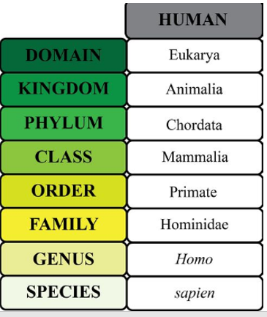
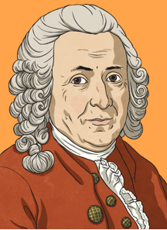

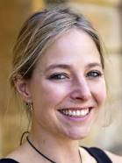
Shirley Heath Biology (Classification)| Year 6 | Spring 2
Key Knowledge
1 | Classification Similar organisms are grouped together then the groups are split again and again to become smaller and more specific until you have groups of animals belonging to one particular species.
2 | Linnaean System The Linnaean system for classifying organisms is a standard system which all taxonomists follow (See diagram below). Domain has been added since Linnaeus developed the system
3 | Identifying organisms Organisms can be identified by belonging to a particular genus and species e.g. a dog is ‘Canis Lupus’. ‘Canis’ applied to dogs and jackals whereas ‘Lupus’ is specific to dogs.
Key Vocabulary
1 | Plants | A living organism in the form of trees, shrubs, herbs, grasses, ferns and mosses.
2 | Animals | A living organism that feeds on organic (living) matter. Typically having sense organs and a nervous system.
5 | Taxonomists | A biologist that groups organisms into categories
6 | Microorganisms | A microscopic organism (too small for the eye to see), especially a bacterium, virus or fungus
Key Diagrams
Important Scientists
1 | Kristopher Helgen (1980- Has discovered nearly 100 new mammal species in his career so far.
2 | Professor Alice Roberts (1973- Biologist at University of Birmingham
Carl Linnaeus A Swedish scientist that collected and examined more than 40,000 specimens of plants, animals and shells. In the 1700s there was no agreed method for classifying organisms until Linnaeus developed one. He published his work in his book ‘Systema Naturae’

