Slide 1
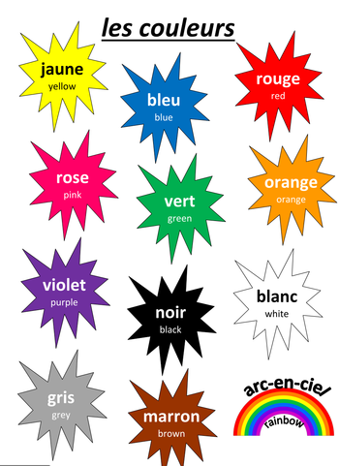
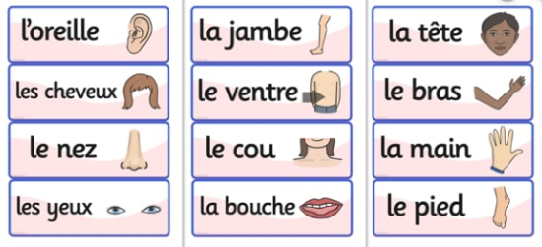



Shirley Heath Portraits | Year 3| Spring 2
Sentences describing people
J’ai … | I have …
Il/elle a … | He/she has …
... le nez bleu. | ... a blue nose.
…la bouche bleue. | ... a blue mouth.
... les yeux /cheveux bleus. | ... blue eyes/hair
Il/Elle est grand(e)/petit(e). | He/She is big/small.
Remember the colour goes after the noun and add –e if the noun if feminine (la).

