Slide 1
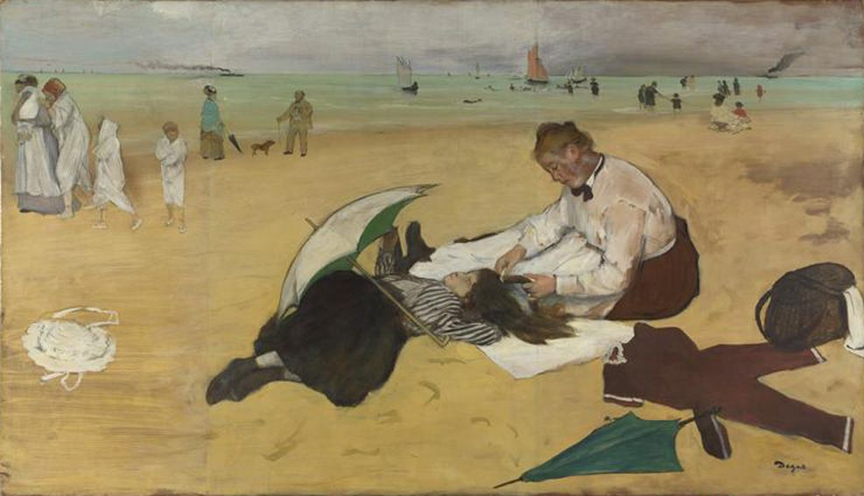

Shirley Heath Scène de plage | Year 5| Spring 2
Degas completed this painting Scène de Plage, showing women, children and dogs. A woman is brushing the hair of a girl, who is laying down, under an umbrella.
nouns from the painting
Le sable | The sand
Le ciel | The sky
La plage | The beach
Une falaise | The cliff
Une grotte | The cave
Le bateau | The boat
La mer | The sea
Vocabulary – sentences about the painting
Le chien regarde l’homme. | The dog is looking at the man
Le bateau glisse sur la mer. | The boat is gliding over the sea
La petite fille dort. | The little girl is sleeping
La dame brosse les cheveux de la petite fille. | The lady is brushing the hair of the little girl
Les gens marchent, parlent et jouent. | The people are walking, talking and playing

